Slide 1
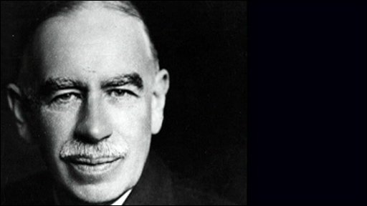
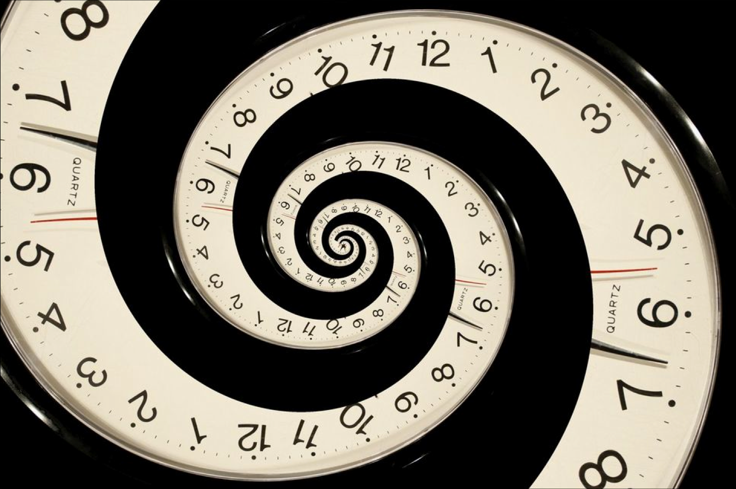
This time is… complex
Keynes on time
Anna Carabelli
Università del Piemonte Orientale
and Mario Cedrini
Università di Torino

Slide 2
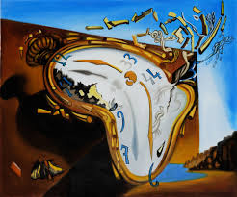
What time is it [Keynes’s]?
“One of the most striking changes in economic thinking which comes primarily with John Maynard Keynes is his explicit focus on time” (Madsen 2014).
Keynes (on Marshall): the element of time “is the centre of the chief difficulty of almost every economic problem” (CW 10: 207).
Two opposite strands:
Keynes’s logical perspective sacrifice the historical dimension of time on the altar of equilibrium (Shackle 1972, Termini 1981, Kaleckians)
The General Theory: historical time, with expectations and uncertainty (e.g. Joan Robinson – see Dutt 2005 –, Chick 1985, 2002, Asimakopulos 1991, Hayes 2006, Fontana 2009), despite logical analysis and references to equilibrium.

Slide 3
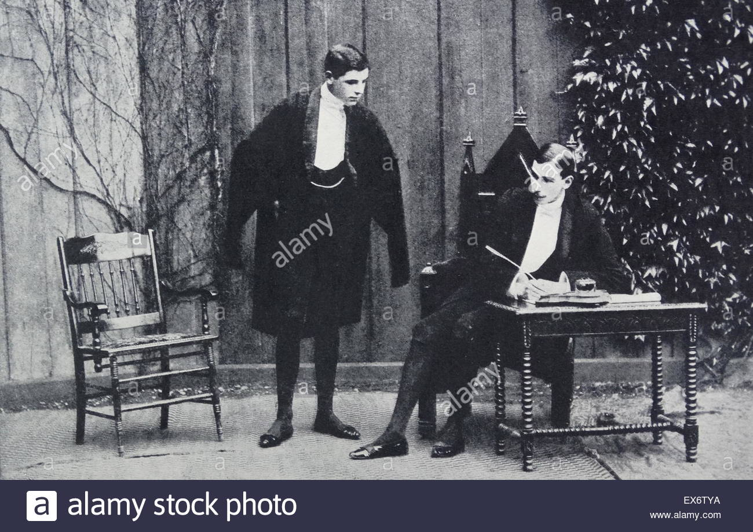
The early Keynes on time (May 8, 1903)
A philosophy of measurement
“Time”, paper read for the undergraduate Cambridge “The Parrhesiasts Society”; written while studying mathematics and attending John Ellis McTaggart’s lectures in Cambridge (and after reading great philosophers’ contributions on the issue, see Harrod 1951, Dostaler 2007, Madsen 2014, 2012).
Main issue: the measurement of time.
A philosophy of measurement Keynes will later apply to the measurement of probability, of the general price level, and finally of aggregate – manifold, or complex – economic magnitudes.

Slide 4
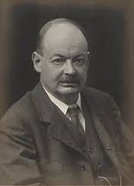
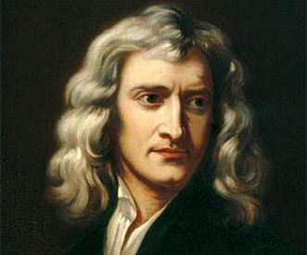
The early Keynes on time (1903) change, relativity, conventions
The “essential interconnection of the ideas of time and change”: “impossible to arrive at any conception of time which should be independent of the conception of change”. The “measure of time is no more than a measure of change”.
“Motion” is relative: “it is impossible to describe the position of anything, except by stating relations between this position and certain other selected positions. So that the notion of … absolute change of position, is an absurdity”.
Hence “the essential relativity of all time measurement”. “For practical purposes … we select certain bodies which we then choose to regard as fixed; we next select some phenomenon of continued change with respect to these bodies, and lay down the laws that equal amount of change take place in equal intervals of time. We have thus arrived at a standard – but purely conventional – measure of time”.
Vs. Newton (General Scholium, 1713): there is no “Absolute Time”.

Slide 5
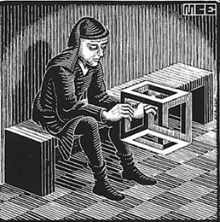
Keynes’s logical approach to economic theory
The legacy of the Treatise on Probability: economics as a “branch of probable logic”, a logical way of reasoning about a “shifting as well as complex” (CW 10: 127), (“unlike the typical natural science”) “in too many respects, not homogeneous through time” economic material (CW 14: 296).
“The object of a model is to segregate the semi-permanent or relatively constant factors from those which are transitory or fluctuating so as to develop a logical way of thinking about the latter, and of understanding the time sequences to which they give rise in particular cases” (ibid.).
A concept of independence for knowledge to grasp “the complexity and interdependencies of the real world” (CW 7: 298): the simplicity of the classical money-wage argument and the importance of “roundabout repercussions” in Keynes’s open-ended theory (cfr. Carabelli & Cedrini 2014, Chick & Dow 2001).

Slide 6

Expectations, time and equilibrium in The General Theory
From the Treatise on Money to the General Theory: or the need to distinguish with clarity “between expected and realised results” (CW 7: 77), expectations (“It is of [their] nature” that they take “into account the time element” (CW 13: 512) determining employment.
Robinson’s historical-time approach requires “the analysis of disequilibrium states in which economic agents have expectations that can be falsified” (Dutt 2005: 127).
The logical theory of the GT presupposes equilibrium (Loasby 1998) and adopts a “static equilibrium” approach, short-term expectations being always fulfilled; a “regression” (Chick 1985: 150) with respect to the “explicitly dynamic method of the Treatise on Money”.

Slide 7
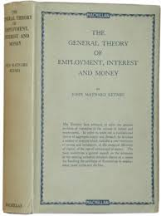
The General Theory: fulfilled short-term expectations?
No need of a “tacit” assumption of fulfilled expectations: disappointments are possible, but changes in the state of long-term expectations or of liquidity preference (“the degree to which the value of an asset, measured in any given standard, is independent of changes in the state of expectation”, 47; see also Rivot 2013) are much more significant in the determination of employment.

Slide 8
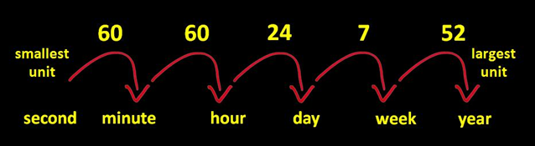
Irrelevance of (units of) time in The General Theory?
Keynes’s theory “underlines many features that are linked to the problem of uncertainty and focuses on an object that is definitely ‘in time’, but lacks analytical relations to account for uncertainty”, relations (e.g. adjustment towards equality of saving and investment) that “are framed in ‘historical time’” (Termini 1981: 74, n. 42; 64; Shackle 1967).
“The unit of time is irrelevant for the analytical purpose of the logical time scheme” (Termini 1981: 64).
But Chapter 4 of the GT addresses “one of the three perplexities which most impeded [Keynes’s] progress in writing this book” (ibid.): the impossibility to find a common unit for complex aggregate magnitudes, in which all relations relative to the quantity under consideration (however quantitative) can be expressed, so as to make numerical comparison possible.

Slide 9
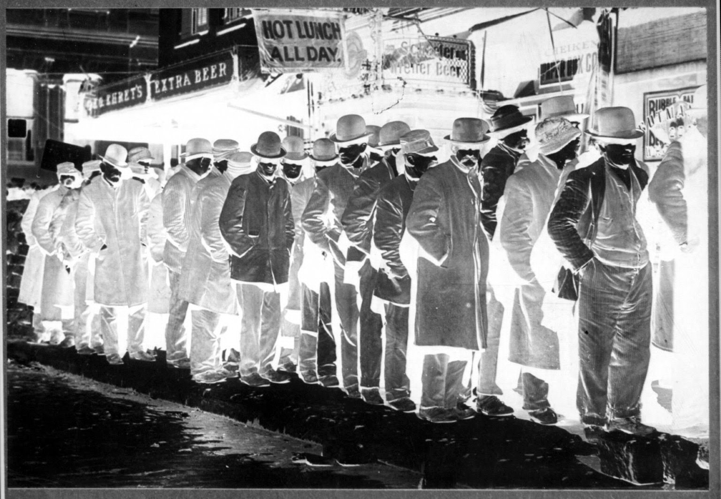
Incommensurability of complex magnitudes
Keynes does not find a proxy for real output by means of deflating the output value by the general price level: he rather opts for the quantity of employment – the two being “presumed to increase and decrease together, though not in a definite numerical proportion” (CW 7: 41) –, which he then defines by means of money-wages.
A tradition that dates back to the Treatise on Probability (early version, 1907) – different kinds of probability impeding numerical comparison and conventional measurement -, and continues with index numbers (1909) – highlighting the intrinsic incommensurability of the general price level, then touched upon in the Treatise on Money (where complex magnitudes are described as multidimensional).

Slide 10

Units of time, after the TM and in the GT
1932 lectures: Units of time “are in their nature homogeneous”, (in Rymes 1989: 104 n.1).
1933 dispute with Robertson on the “technical day” (“I cannot discover what you gain by your ‘days’, which seem to me to stand in the way of dealing with a period as a whole”. “Is the technical day the same for everyone?”. “About how long do you believe it to be in practice?”, CW 29: 19, 26).
“Definitions and ideas relating to capital”, 1933: “accounting” period as “the time which must elapse between the decision which will lead [an entrepreneur] to incur variable cost and the date when he will recoup himself by selling the resultant output” (74).
GT, Chapter 5: “the minimum effective unit of time” (CW 7: 47, n.1), the “day”, as “the shortest interval after which the firm is free to revise its decision as to how much employment to offer”, ibid.).
Chapter 16: employment as “the sole physical unit which we require in our economic system, apart from units of money and of time” (214).

Slide 11

Keynes on time relationships
Bradford and Harcourt 1997 (119): “It was not until after the publication of The General Theory that he systematically applied the reasoning of Chapter 4 to the question of time”.
Notes for the 1937 lectures: “ex ante saving a very dubious concept – the decision don’t have to be made” (CW 14: 182). Nor is there any necessity “to make a definite decision (as the investors have to do) … [and] they do not make it at the same time”. “Ex ante is solely the domain of entrepreneurs’ decisions” (Gnos 2004: 338).
“Time relationship between effective demand and income” is “incapable of being made precise. In case of factors other than entrepreneurs and rentiers the two are more or less simultaneous. For the latter income becomes determinant and is transferred at varying subsequent dates” (CW 14: 179). There is “no definite relationship between aggregate effective demand at one time and aggregate income at some later time” (179-180).

Slide 12
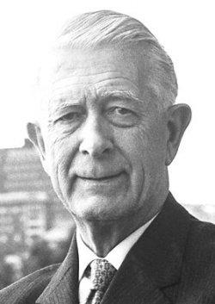
Vs. the Swedish approach
The “contraption of formulas of process of all sorts of lengths depending on technical factors with income emerging at a given date corresponding to input at an earlier date” (CW 14: 180) finally discarded “partly because it was frightfully complicated and really no sense in it, but mainly because there was no determinate time unit”.
Letter to Ohlin of January 7, 1937:
“My reason for giving [the ex post and the ex ante method] up was owing to my failure to establish any definite unit of time … my new treatment was much safer and sounder from a logical point of view”.
“I used to speak of the period between expectation and result as ‘funnels of process’, but the fact that the funnels are all of different lengths and overlap one another meant that at any given time there was no aggregate realized result capable of being compared with some aggregate expectation at some earlier date” (CW 14: 184-185).

Slide 13
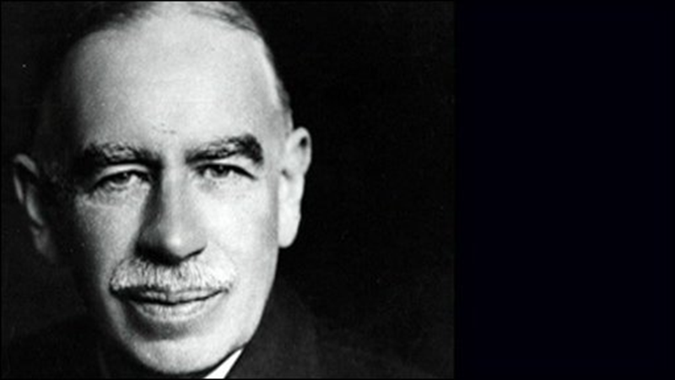
Conclusions: on Keynes’s approach to time
Keynes on time, or how to use it safely in economic analysis (where non-homogeneity through time and resulting problems in comparing economic magnitudes prevail):
Econometrics as wrong solution to the problem: economics deals with “the influence of expectations and of transitory experience” (CW 14: 2)
time is relative – hence a logical approach to economic theory (and complexity)
time is change: entrepreneurs’ expectations in determining effective demand
measurement of time as highly conventional
Units of time as devices to separate (relatively) constant from changing factors and as “theoretical link between to-day and to-morrow”.

