Slide 1
Making financial instability visible in space as well as time: Toward a more Keynesian geography
Gary A. Dymski
Professor of Applied Economics
Leeds University Business School
Forthcoming in Money and Finance after the Crisis, co-edited by Brett Christophers, Andrew Leyshon, and Geoff Mann (Wiley-Blackwell).

Slide 2
A celebration of Vicky’s work
“The theory of saving and the rate of interest can – or at any rate should – never be independent of the state of development of financial institutions.”
    V. Chick, “The evolution of the banking system and the theory of saving, investment, and interest,” Économies et sociétiés, Série MP, No. 3, 1986.
Author’s note in the 1996 volume Money, Method, and Keynes:
“my mind wandered to liability management, a phenomenon which had been much discussed in the UK but only in the money-and-banking frame of reference. What difference did it make, I wondered, in the larger framework of macroeconomics?”

Slide 3
“Some reflections on financial fragility in banking and finance,” Journal of Economic Issues, June 1997
“The most valuable lesson I learned as a student of Hy Minsky’s at Berkeley I learned after the seminars. Hy always had good attendance at his Money and Banking seminars from the Bank of California and the San Francisco Fed … [Afterward] at a local bierstube ... I would watch fascinated as Hy .. Would turn first to a student, then to a banker, asking .. theoretical questions to unworldly students and matters of practice and policy to the bankers. There seemed to be two entirely separate worlds of discourse – only Hy seemed able to live in both at once. ... In the next seminar, the answers to practical questions became part of the theoretical discourse, and theory would be turned to .. some aspect of bank behavior we had heard about over beer. Despite all the pressures of the mainstream search for ‘pure’ theory, Hy never departed from this method: the historical and institutional contingency of economic theory is a hallmark of Hy’s work.”

Slide 5
Making financial instability visible in space as well as time: Toward a more Keynesian geography
Why has the growing body of geographic research on finance, stimulated to new heights by system-shaking financial crises, neglected financial instability?
Bringing financial instability into focus means making space in geographic financial discourse for the impact of real time and uncertainty.
These core elements of Keynes’ ideas are needed if money and credit are to play an essential analytical role, and hence an adequate basis for conceptualizing financial instability.
So bringing financial instability into spatial analysis requires a more Keynesian geography.

Slide 6
Harvey’s approach to money and credit, and his theory of capitalist crisis
Corbridge and Thrift (1994): money, despites being at the centre of recent global crises, is neglected in geography.
Harvey’s pioneering 1980s writings showed how money and credit relations are central to capitalist – and especially urban – dynamics.
Corbridge and Thrift objected to Harvey’s maintained hypothesis: while financial phenomena accompany capitalist crises, these crises are moved by deeper causes. So financial dynamics are epiphenomenal.
These scholars’ volume helped launch financial geography as a subfield of geography, including topics from financial exclusion to pension-fund investment.

Slide 7
Financialization: a mirror validating every theorist’s pre-analytical vision?
An unanchored concept: The rising “geography of finance” accompanied the growing prominence of financial activity within capitalist economies – that is, “financialization.”
But financialization has been so broadly defined that it has been twisted into many shapes.
Christophers (2015) has argued that “financialization” has come to mean everything and nothing.
So he has (Christophers 2016) asserted that the subprime crisis can be attributed to end of Fordism.

Slide 10
Subprime meltdown 2007-08: A “very spatial crisis”
The subprime crisis in 2007 and European financial crisis in 2010 spurred much new geographic work on how financial systems operate in and across space.
Geographers have documented the fundamentally spatial character of the subprime crisis (Aalbers 2009, French, Leyshon, and Thrift 2009, Martin 2011).
This work has emphasized how these crises have been shaped by the social and market power that has accrued to the financial industry and is concentrated in global financial centres (Wójcik 2013).
But the different strands of geography work all ignore financial instability, Minsky, and Keynes. For them, Keynes = Keynesian welfare state.

Slide 11
The Keynesian pathway for the policy relevance of economic geography
The absence from geography of financial instability – which, as noted, rests on real time and Keynesian uncertainty – has many important consequences.
The inattention to real time and uncertainty in conceptualizing finance leaves geographers without an analytical bridge to core Keynesian and Minskyian ideas, and thus to the work of (primarily) heterodox economists who reject equilibrium and insist that financial instability emerges endogenously in capitalist dynamics.
It also constitutes a barrier to geographers being more centrally engaged in policy debate about finance and global financial crisis. For as Pryke (2011) wrote, “now … is the time for geographers of finance to make significant contributions to research and policy agendas.”

Slide 12
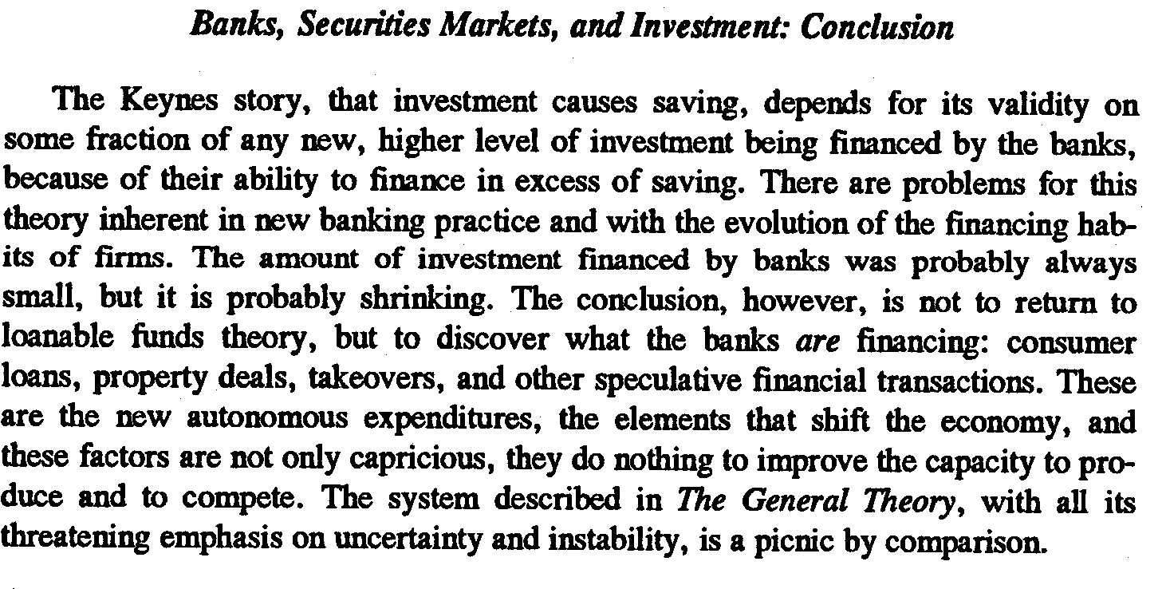
Vicky’s warning: new financial practices require new theoretical insights (JEI 1997)

