Slide 1
The General Theory and Victoria Chick at 80: A Celebration
University College London
Monday 11 July 2016
Carlos J. Rodríguez-Fuentes
University of La Laguna
A personal interpretation of Victoria Chick’s thought on monetary policy: intellectual rigor, scientific innovation and common sense
Organized by the PostKeynesian Economics Study Group (PKSG) and the Association for Heterodox Economics (AHE)

Slide 2
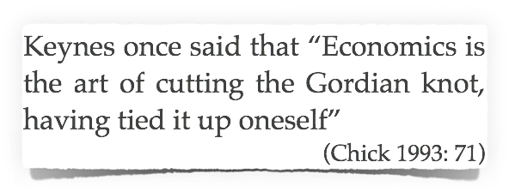
The Pursuit of Truth in the Company of Friends
Cowell College - University of California at Santa Cruz
Thank you Vicky for …
your intellectual rigor,
strong commitment,
passion and coherence,
curiosity, creativity, altruism
… and sincere friendship
Real economists are “those who know what their values are and put them forward for public debate
Prof. Victoria Chick
The Guardian, 18 November, 2011

Slide 3
Also deals with macro and methodological issues (Chs. 1 and 8)
The Theory of Monetary Policy
1973
Macroeconomics
After Keynes
1983
Also touches money and monetary policy (Chs. 9, 10 and 18)
Money in the income-generating process
Academic papers
1978 - 2014
Theory of investment, finance and interest
The monetary change is only “one half of the story”; it always matters the way the monetary increase takes place
The evolution and structure of the banking system matters for the way money and monetary policy works

Slide 4
Some selected academic papers
1978 - 2014
Unravelling the assumptions and logical foundations of theories
Searching for the historical particularities of theory
“Most of us use theory […] without much thought about their institutional background and implicit assumptions”
(Chick 1993: 55)
The monetary change is only one half of the change
The stages of banking development and the theory of finance
A better understanding of the “transmission mechanism”
The Post Keynesian regional finance literature

Slide 5
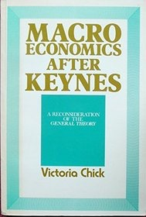
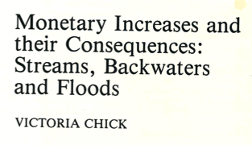
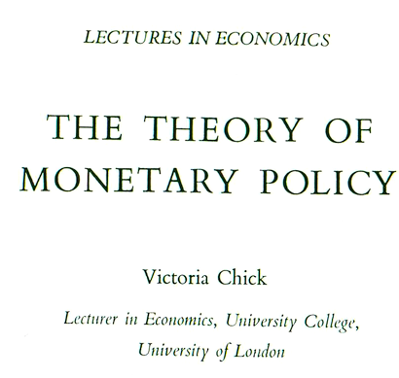
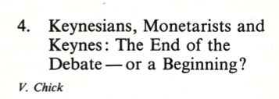
Unravelling the assumptions and logical foundations of theories on money
1984
1977
1983
2014
1978
2002
1985

Slide 6
A better understanding of the “monetary change”
Conventional | Victoria Chick
Keynesian and Monetarist assume that the mode of introduction of new money is a matter of indifference | Money always comes in exchange for something else, as a counterpart of an income-generating expenditure (whether investment, government expenditure or credit-financier consumption)
 | A monetary change is “only one half of the process” and can be originated by very different ways … with relevant implications for the final outcome
The main theme [in monetary policy] is the effects on the economy of a change in the quantity of money and the study of the transmission mechanism | It is non-sense to discuss about the monetary transmission divorced from the type of monetary change being considered Chick (1985: 96). “Keynesians theory lost track of the sources of monetary increases Keynes had in mind … and propose an interest-rate consequence of ALL monetary changes (Chick 1988: 11)
 | The effect of the monetary change depends on how people behave […] on which there is no widely accepted presumptions of behavior. The final effect is contingent upon the state of the economy at the time of the change and upon who issues the money and in exchange for what. The first is familiar […] the second is denied. (Chick 1978: 160)
 | The interrelatedness of fiscal and monetary policy arises for the fiscal stimulus (when it is financed by new money) can be one the counterparts of the monetary change.
Excess money is always inflationary | Whether the new money (or newly active money) is necessary inflationary … depends on technology and competition for resources … it is not a monetary problem really (Chick 1984)

Slide 7
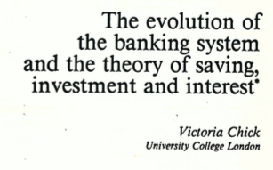
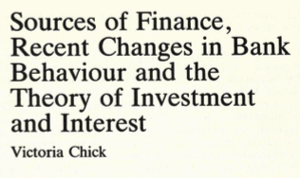
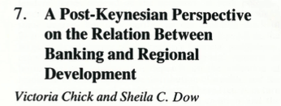
Thinking about the historical particularities of theories … Victoria Chick arrives at the stages of banking development … and further
1988
1986
1989
1988
1993
1998

Slide 8
Chick’s stages of banking development: the implications
1. “Intensifies the subordinate position of saving with regard to investment” (Chick 1986: 124)
2. Questions the convention of considering the transmission mechanism “as a purely theoretical matter, independently of institutional context” (Chick 1988)
3. Provides a framework to explains “why the relevant monetary monetary changes according to changes in the institutional setting” (Chick 1988: 17)
4. As a result of its combination with Sheila Dow’s work on regional finance, provides a framework to explore the contribution of money and banks to regional development which goes beyond the narrower conventional Keynesian regional credit-rationing literature (based on the Loanable Funds Theory)
5. Reading between lines … it also forecasts potentially “bad news”?
“The proposition that investment evokes the necessary saving feels hopeful and progressive. It is far less attractive to say that speculation [in City property] evokes the necessary saving to finance it (Chick 1986: 121)
Does this theory predict that banking development might bring higher financial instability, lower banking functionality … and financialization as well?

Slide 9
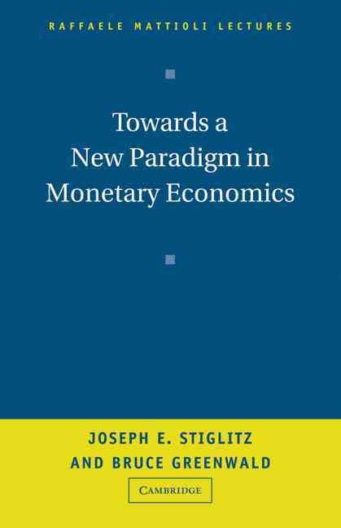
One final and important remark!!!
“The object of this papers is to trace certain development in the co-evolution of the British banking system and the theory and methods of monetary policy” […] I do not claim to have a new, relevant theory of monetary policy […] I wish only to expose hidden assumptions of existing theories” (Chick 1988: pages 1-3)
“Existing theoretical models, largely institutional independent, provide little or no guidance for assessing the effect these [institutional] changes on monetary policy” (Stiglitz and Greenwald (2003: 4)
“there are market differences in the effectiveness of monetary policy in different countries, and similarly marked differences in their institutional structures. We argue that the changes in the monetary relations over time and differences across countries can be linked to institutional variations in the banking system” (Stiglitz and Greenwald 2003: 4)

Slide 10
Stiglitz, it was Victoria Chick (not you) …. who cut (in 1988) this Gordian knot

