Slide 1
Teaching a pluralist first year macroeconomics course utilising blended learning
Martin J. Watts
Newcastle Business School
The University of Newcastle
NSW, Australia
Martin.Watts@Newcastle.edu.au

Slide 2
What is Blended Learning (BL)?
In its basic and simplest definition, blended learning is an instructional methodology, a teaching and learning approach that combines face-to-face classroom methods with computer mediated activities to deliver instruction. The strengths of this instructional approach is its combination of both face to face and online teaching methods into one integrated instructional approach (http://www.educatorstechnology.com/2014/04/the-four-important-models-of-blended.html).
In practice at the University of Newcastle, we had 4 hours of contact in the 1st year Macro course: 2 hour Lecture, 1 hour tutorial & 1 hour Workshop,
This was replaced by a 2 hour workshop plus online material including short topic based lectures, videos, quizzes…
The focus of BL is on students being responsible for their preparatory learning through their work outside the classroom, which then enables higher level learning in workshops.

Slide 3
What is Blended Learning?
The workshops are conducted in custom built classrooms with tables each holding 5 students, which are shaped and aligned so all students can see the main screen. The largest room holds 85 students.
Each table has a computer which is linked to the main computer.
Workshops consist of a number of activities:
  Short presentations by the instructor;
  Videos and other online media
  Group learning activities undertaken by the 5 students at each table with interaction also with the Instructor and/or an Assistant, who provides direction and promotes discussion.
The major issue is the lack of time. If students are not prepared, then presenting some form of lecture in the workshop is very tempting.
However most students seem incapable of processing the material from lectures so they are unable to apply the associated concepts and theories straight away in the workshops, in the absence of prior preparation.

Slide 4
What is Blended Learning?
This year we had a temporary respite. Some courses have a 3 hour workshop, which we considered to be too long for first years.
We negotiated a separate hour’s lecture, but attendance tends to be poor!
Has this shift to BL been the outcome of a detailed and rigorous assessment of the available evidence? No. It is driven (inpart) by relocation of the NBS to a new building in the city with the largest lecture theatre holding 110!
There are studies of course, e.g. Garrison & Kanuka (2004): ‘The conclusion is that blended learning is consistent with the values of traditional higher education institutions and has the proven potential (??) to enhance both the effectiveness & efficiency of meaningful learning experiences.’
Rigorous studies are difficult because of content being changed to fit in with the change in mode of teaching.
UTS & RMIT also relocated their Business Schools and adopted BL!

Slide 5
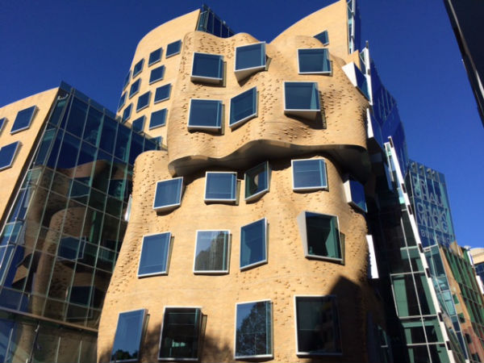
Frank Gehry New Age UTS Building!

Slide 6
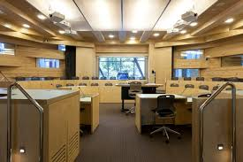
UTS Classroom

Slide 7
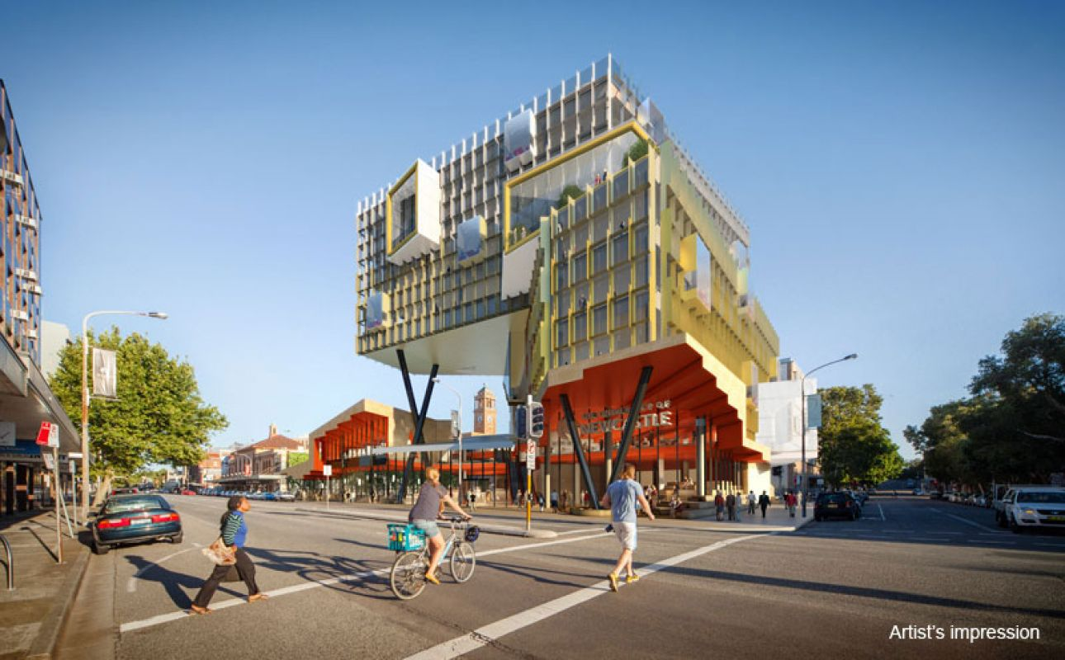
NewSpace, The University of Newcastle

Slide 8
Pluralism
I started co-teaching ECON1002 Macro in the Global Economy in 2012. I resolved not to teach from a traditional textbook with all its flaws.
But a monist course based on PK economics was inappropriate too, given intense debates about post-GFC policy, & our responsibilities as educators.
Thus a pluralist course which would expose the contested nature of economics & develop students’ critical thinking skills was needed, but the heterodox dimension needed a clear conceptual/ theoretical framework.
MMT about which I had been writing since the 1990s, was appropriate.
By the end of 2015, pressure was mounting to return to a conventional textbook, due to poor evaluations, in part reflecting the shift to blended learning and reduced contact hours, and also because Randy Wray & Bill Mitchell had not yet completed their first and second year textbook.
I offered my assistance to Bill and Randy……

Slide 9
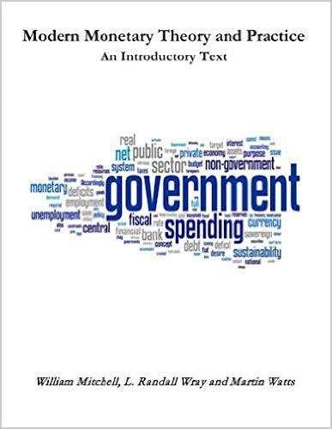
This Amazon text became available to students in late March.
Student evaluations improved, due to, we think, improved delivery and organisation under the BL regime and the presence of a textbook.
Negotiations are in progress with an academic publisher for the 2 year textbook which we optimistically plan to complete by the end of August!

