Slide 1
An Introduction to Post Keynesian Economics and Political Economy
PKSG
5-7 July 2017, Kingston University

Slide 3
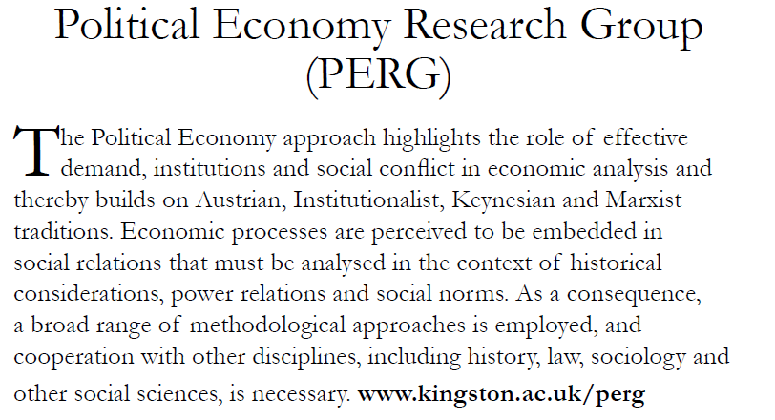

Slide 4
MAs at Kingston
MA Political Economy http://www.kingston.ac.uk/postgraduate-course/political-economy-ma/
MA Economics (Political Economy) http://www.kingston.ac.uk/postgraduate-course/economics-political-economy-ma/
MA International Politics and Economics http://www.kingston.ac.uk/postgraduate-course/international-politics-economics-ma/
MA Philosophy and Political Economy http://www.kingston.ac.uk/postgraduate-course/philosophy-political-economy-ma/
European MA EPOG (Economics in the age of globalisation)
http://epog.eu

Slide 5
Rethinking Economics is an international network of students, thinkers and citizens, coming together to demystify, diversify, and invigorate economics.
We aim to demystify and diversify economics in the public eye; to educate ourselves and other students in a more reflective economics; to inspire divergent economists to engage with one another in debate; and to promote a politics of responsibility within academic economics.
We are always looking for more organisers and collaborators. Please join our mailing list using the form on this page or get in touch directly.
Our aims
ACADEMIC To bridge disciplines within and outside of economics; to advance neglected but critical economic perspectives and methodologies; to promote collaboration, humility and ethical practice in academia.
EDUCATIONAL To demystify economics as a technical science, building open and collaborative communities of economic thinkers. To expand the creativity and social awareness of our future economists and citizens. To bring the basic tools of economic analysis into the hands of all of us who participate in a society shaped by economic forces.
POLITICAL To equip us all with the ability to organise effectively, and to get economics students and academics to recognise their roles and responsibilities as political actors within their institutions and within wider public life.

Slide 6
Wednesday 5 July
PKSG
9.30-11.00: Engelbert Stockhammer, Kingston University Post Keynesian Economics, Introduction & Overview
11.00-11.30: Tea and coffee
11.30-1.00: Özlem Onaran, University of Greenwich Aggregate Demand, Income distribution and the Causes of Unemployment
1.00-2.30: Lunch
2.30-4.00: Jo Michell, University of the West of England A Monetary Production Economy
4.00-4.30: Tea and coffee
4.30-6.30: Panel discussion: Post Keynesian Economic Policy (Özlem Onaran, Jo Michell, Jesper Jespersen)
7.30: Drinks at The Ram (Pub in Kingston)

Slide 7
Thursday 6 July
PKSG
9.30-11.00: Simon Mohun, Queen Mary University Introduction to Marxian Political Economy
11.00-11.30: Tea and coffee
11.30-1.00: Antoine Godin, Kingston University A monetary theory of production. An introduction to SFC modelling
1.00-2.00: Lunch
2.00-3.30: Ewa Karwowski, Kingston University Development in Post Keynesian and Marxist theories
3.30-4.00: Tea and coffee
4.00-6.00: Panel discussion: Financial Stability, Development, Socialism: What Does it Mean for Economic Policy? (Simon Mohun, Antoine Godin, Ewa Karwowski)
Group Photo
7.00: Drinks at The Grove (Pub in Kingston)

Slide 8
Friday 6 July
PKSG
9.30-11.00: Gary Dymski, Leeds University Post-Keynesian and Marxian Approaches to Economic Policy: Can Global Capitalism be Tamed?
11.00-11.30: Tea and coffee
11.30-12.00: Student working groups in preparation of the Concluding Panel
12.00-1.15: Concluding Panel: The State of Political Economy and Progressive Economic Policy. Open questions of the workshop (Engelbert Stockhammer, Gary Dymski and Ewa Karwowski)
1.15-2.15: Lunch
2.15-3.45: Rethinking Economics: Challenges and Achievements. Panel discussion on student initiatives and heterodox economics (John Smith: Kingston Rethinking Economics, Samiah Anderson: Rethinking Economics, Kevin Dean: Reteaching Economics, Engelbert Stockhammer: Kingston University, Gary Dymski: Leeds University)

Slide 9
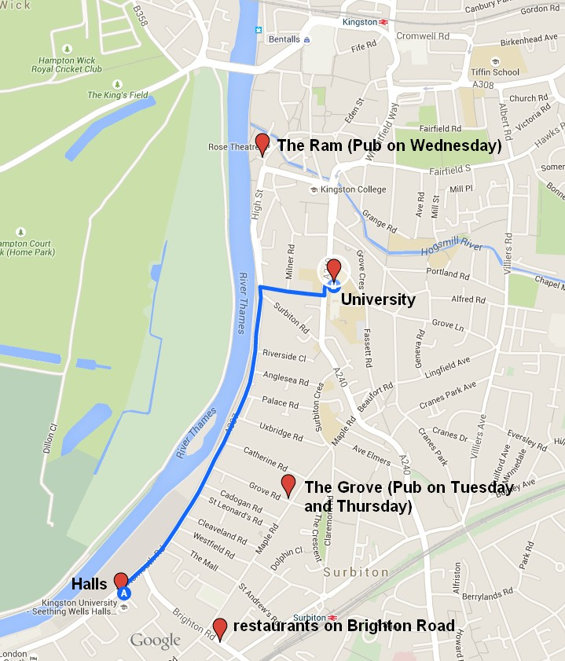
PKSG

Slide 10
Journals
CJE – Cambridge Journal of Econmics
JPKE – Journal of Post Keynesian Economics
ROPE – Review of Political Economy
IRAE – International Review of Applied Economics
ROKE – Review of Keynesian Economics
EJEEP/Intervention – European Journal of Economics and Economic Policies
Metroeconomica
RRPE – Review of Radical Political Economics
Capital & Class

Slide 11
PK & PE conferences
PKSG email list http://www.postkeynesian.net/
Heterodox Economics Newsletter
PKSG Annual Workshop, UK, June -- PK
FMM conference, Berlin, end Oct -- PK
Bilbao, early July -- PK
EuroMemo, Sept -- eu ec policy
EAEPE, early/mid Nov – mixed heterodox econ (European Association of Evolutionary Political Economy)
AHE, July, London or other UK – Association of Heterodox Economics
IIPPE – International Initiative for Promoting Political Economy
HM, early Nov, London – Historical Materialism

Slide 12
Unis for PG studies
Kingston
Greenwich
Leeds
SOAS (London)
Paris 13
Berlin BSLE
Umass Amherst; PERI (USA)
New School (USA)
UMKC (USA)
Levy Institute (USA)

