Slide 1
Adding your title
Feminist Economics
Leila Gautham
University of Leeds
PKES Summer School 2024
June 20

Slide 2
Text sizes and hierarchy
Outline
What is feminist economics?
    Defining work
    Measuring economic activity
    Conceptualizing individuals and households
    Methods
Applications
    Gender gaps in pay
    Unpaid work and living standards
Macro questions
    Feminist macro models
    Crises and austerity

Slide 3
Text sizes and hierarchy
What is feminist economics?
Studies gender roles in the economy; recognizes that gender matters for economic processes/outcomes
Studies biases in the content and methodology of the economics discipline
Studies social provisioning (everything that human beings need to survive and flourish) [content]
    “The goal of Feminist Economics is not just to develop more illuminating theories, but to improve the conditions of living for all children, women, and men” (www.feministeconomics.org).

Slide 4

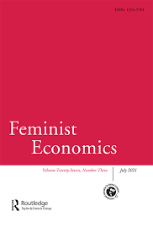

Text sizes and hierarchy
Who are feminist economists?
This is what a feminist economist looks like. Photo series by Stephanie Seguino (http://www.stephanieseguino.com/this-is-what-a-feminist-economist-looks-like.html)

Slide 5
Text sizes and hierarchy
Starting points
Economic activity: market/paid work and unpaid work
Interaction between social norms, individual preferences and behavior, and policies
Economic outcomes/processes shaped by gender, which intersects with other social identities
Human well-being (not income) the yardstick of economic success
Pluralism in methods and models

Slide 6
Text sizes and hierarchy
Mainstream economists also now work increasingly on gender and families.
Where do feminist economists differ from mainstream perspectives?
Defining work
Measuring and valuing economic activity
Conceptualizing the individual
Modeling household decisions
Methods
(And from other heterodox approaches in some dimensions.)

Slide 7
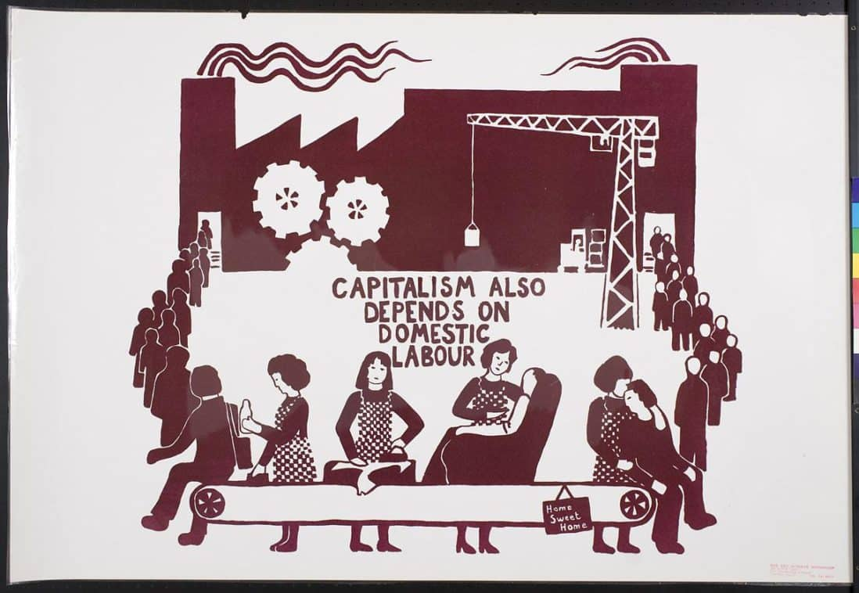
Text sizes and hierarchy
What is work?
Source: Red Women’s Workshop © 2019 Oakland Museum of California.

Slide 8
Text sizes and hierarchy
Defining work
Unpaid work (housework or caring for children and other dependents) usually not included in economic definitions of “work.”
What is work?
Mainstream: work as disutility, requires compensation/income (work = paid work)
Feminist: any activity that one could, at least in theory, pay someone else to do (work = paid + unpaid work) (also known as the third-party or Reid criterion)

Slide 9
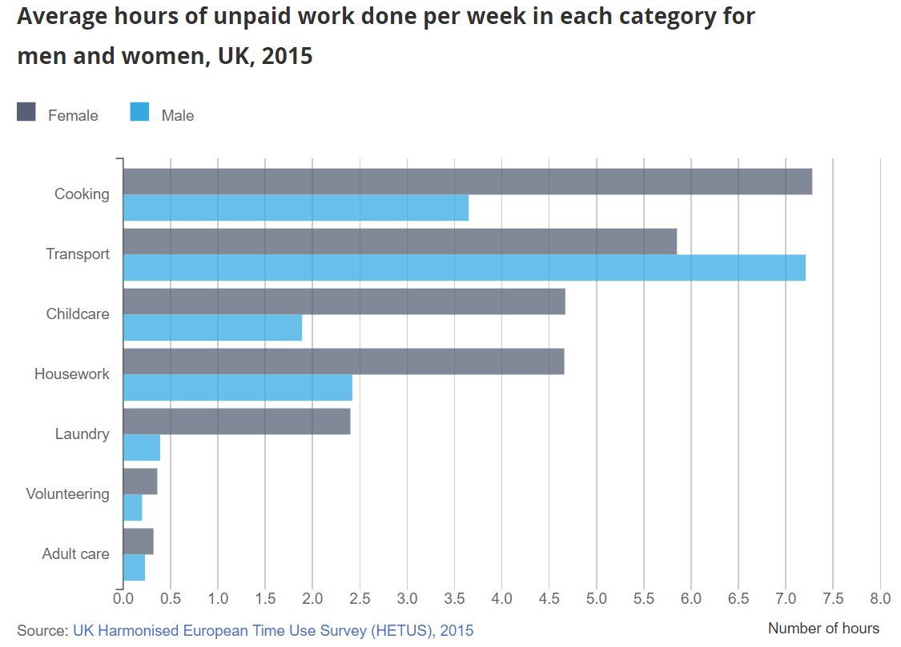
Text sizes and hierarchy
What is at stake?
Source: “Women shoulder the responsibility of 'unpaid work'.” ONS 2016. shorturl.at/lqAZ7. Men do about 16 hours of unpaid work a week, on average, while women do 26.
Notes:
On average men do 16 hours a week of such unpaid work, which includes adult care and child care, laundry and cleaning, to the 26 hours of unpaid work done by women a week. The average man would earn £166.63 more per week if his unpaid work was paid, whereas the average woman would earn £259.63 (using 2016 data on earnings).

Slide 10
Ought we to quantify the value to unpaid work?
Why? (Or why not?)
How would you value an hour of unpaid work?

Slide 11
Text sizes and hierarchy
Measuring economic activity
Existing measures of economic activity (e.g., GDP) value unpaid work at zero
Unpaid work makes important contributions to living standards
It also helps generate human capabilities, intrinsically valuable but also important for economic growth
Principles of valuation (see Folbre 2015 on reading list): replacement vs. opportunity costs

Slide 12
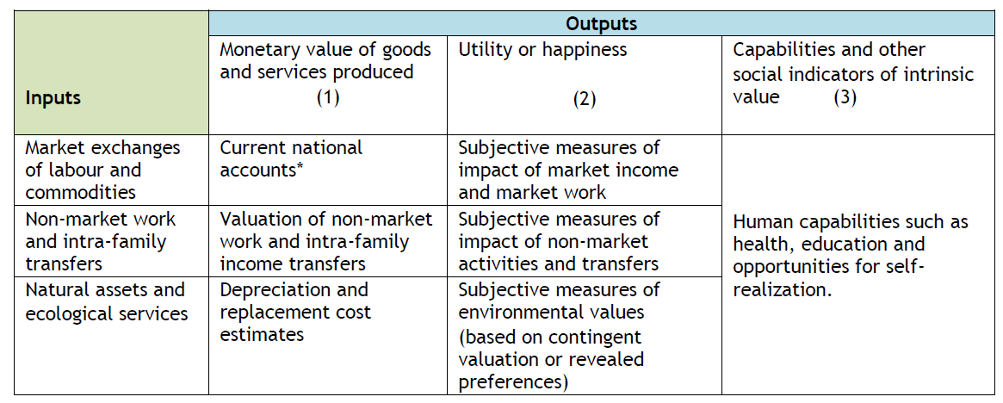
Text sizes and hierarchy
Measuring economic activity (cont.)
GDP
Source: Folbre (2015)

Slide 13
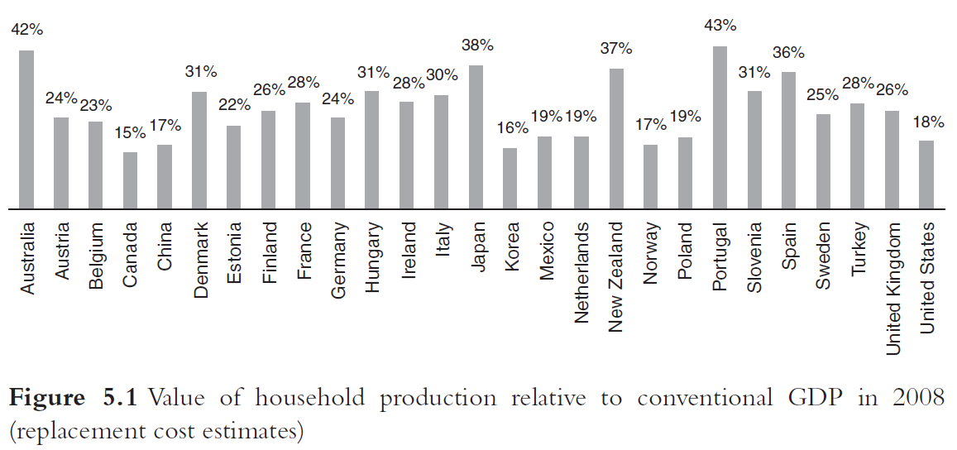
Text sizes and hierarchy
The value of household production
Source: Fischer et al. Rethinking Economics, chapter 5. “Feminist Economics”

Slide 14
Text sizes and hierarchy
Thinking about the individual
Homo economicus: the “economic man” of neoclassical economics: independent decisions and exogenous preferences
    Recent mainstream work on gender: preferences vs. discrimination dichotomy
    (see Lundberg 2023 for an excellent critique)
  For example: women have lower pay because they “choose” occupations and employers that satisfy their “preferences” for flexibility or helping others.

Slide 15
Text sizes and hierarchy
Why does this framing matter?
Feminist economists emphasize a historically specific analysis that is attentive to social structures.
    Social embeddedness
    Preferences influenced by social norms
    Social norms themselves are the product of collective action and policy
  See England 2005 on the reading list for feminist theories of care.

Slide 16
Text sizes and hierarchy
Modelling households
Gary Becker’s A Treatise on the Family (1991) extends neoclassical economics/rational choice theory to families
Unitary decision-making: altruistic [male] household “head”
Efficient outcomes
Feminist economics: household decisions formed by bargaining between family members
Fallback positions (power) matter for household outcomes
Inefficient outcomes are possible
Empirical evidence: intrahousehold distribution of consumption depends significantly on which household members receive or control income.

Slide 17
Text sizes and hierarchy
Household bargaining in feminist economics
Household decision making
Paid labor supply and unpaid work of household members; fertility; resource allocation and consumption; intra-household wellbeing
Assets (wealth, land, social capital)
Bargaining power (weight placed on individual’s preferences and wellbeing)
Fallback position (individual’s position if household relations breaks down)
Social norms (gender roles, traditions)
Social institutions and state policies

Slide 18
Text sizes and hierarchy
Methods
Mainstream claim: detached, value-free, rigorous empirical methodology
Feminist economists contest this claim to neutrality;
    critique devaluation of alternative models and methods and mainstream emphasis of rigor over social relevance
Instead:
Qualitative methods, archival research, mixed methods
Interdisciplinarity
(see Kabeer 2020 on reading list)

Slide 19
Bringing together debates between feminist and other economists on work, care, preferences, and families:
the gender wage gap …

Slide 20
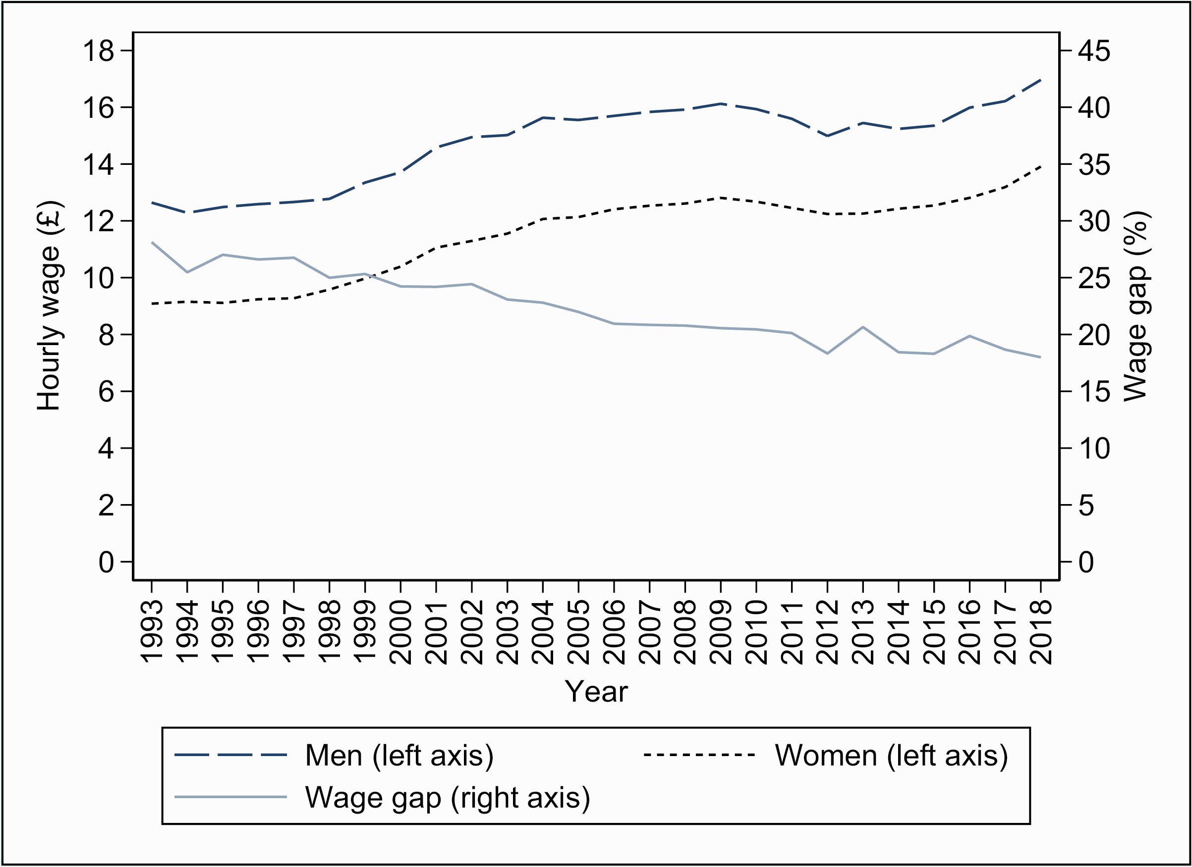
The gender wage gap in the UK
Source: Costa Dias et al. 2021 (https://doi.org/10.1093/oxrep/graa053). LFS 1993–2018. The gender wage gap is the percent difference in male and female average hourly wages.
Notes:
The gap has decreased over the last 20 years from almost 30 per cent in 1993. Currently, the average female employee earns around a fifth less per hour than the average male employee. It is not a ‘like-for-like’ comparison between otherwise-identical workers or jobs. One reason why wage differentials between men and women might have changed over this period is that their relative levels of education have also changed. This is actually an important aspect to take into account in interpreting the declining wage gap over time. The increase in education was faster for women, who overtook men by the late 2000s and are now more likely than men to have a university degree.

Slide 21
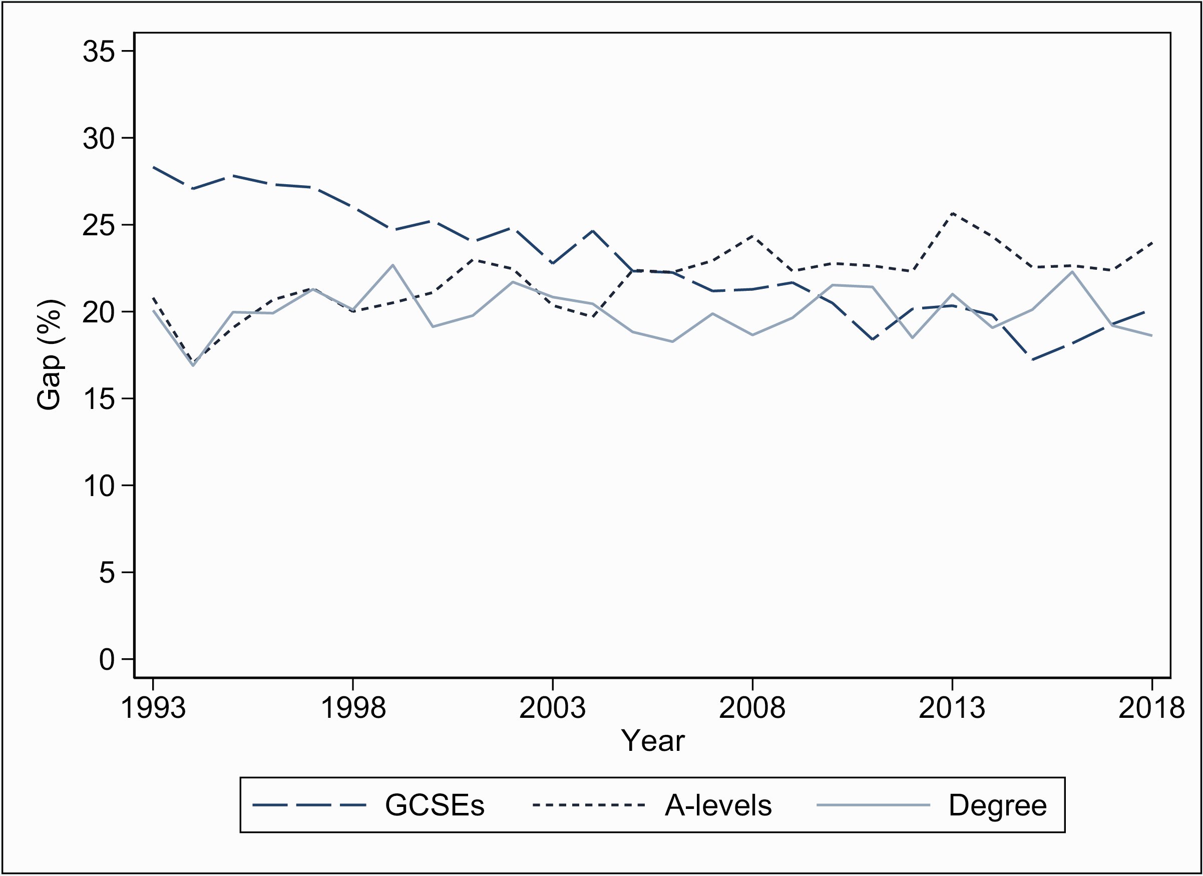
By highest educational qualification …
Source: Costa Dias et al. 2021 (https://doi.org/10.1093/oxrep/graa053). LFS 1993–2018. The gender wage gap is the percent difference in male and female average hourly wages.

Slide 22
What could be some explanations for why women, on average, earn less than men?

Slide 23
Firms, industries, and occupations
Occupation and industry are now the biggest explanators of gender wage differences (Blau and Kahn 2017 for the U.S.)
Jewell et al. (2020) find that 16% of the gender wage gap in the U.K. is accounted for by firms:
  Men locate in firms that pay higher wages to all their employees
  The equivalent contribution from occupations is just 6 percent.
Why does where you work matter so much for gender pay inequality?
Notes:
Gender wage gap by time to/since birth of first childNotes: UKHLS 1991 to 2017. Wage gap measured in proportion of male wages. Observations in the top one and bottom two percentiles of the wage distribution are excluded. The age-adjusted series shows the gap obtained from wage rates net of education-specific age effects.

Slide 24
Care sector employment
Source: Current Population Survey data for the U.S. from 2013-2019. Restricted to full-time, full-year, private sector employees.
Notes:
Gender wage gap by time to/since birth of first childNotes: UKHLS 1991 to 2017. Wage gap measured in proportion of male wages. Observations in the top one and bottom two percentiles of the wage distribution are excluded. The age-adjusted series shows the gap obtained from wage rates net of education-specific age effects.

Slide 25
Care sector penalties
  Why do care providers earn so little?
  See England and Folbre 1999 for early feminist theorizations of the cost of doing care work.
Source: Current Population Survey data for the U.S. from 2013-2019. Restricted to full-time, full-year, private sector employees.
Notes:
Gender wage gap by time to/since birth of first childNotes: UKHLS 1991 to 2017. Wage gap measured in proportion of male wages. Observations in the top one and bottom two percentiles of the wage distribution are excluded. The age-adjusted series shows the gap obtained from wage rates net of education-specific age effects.

Slide 26
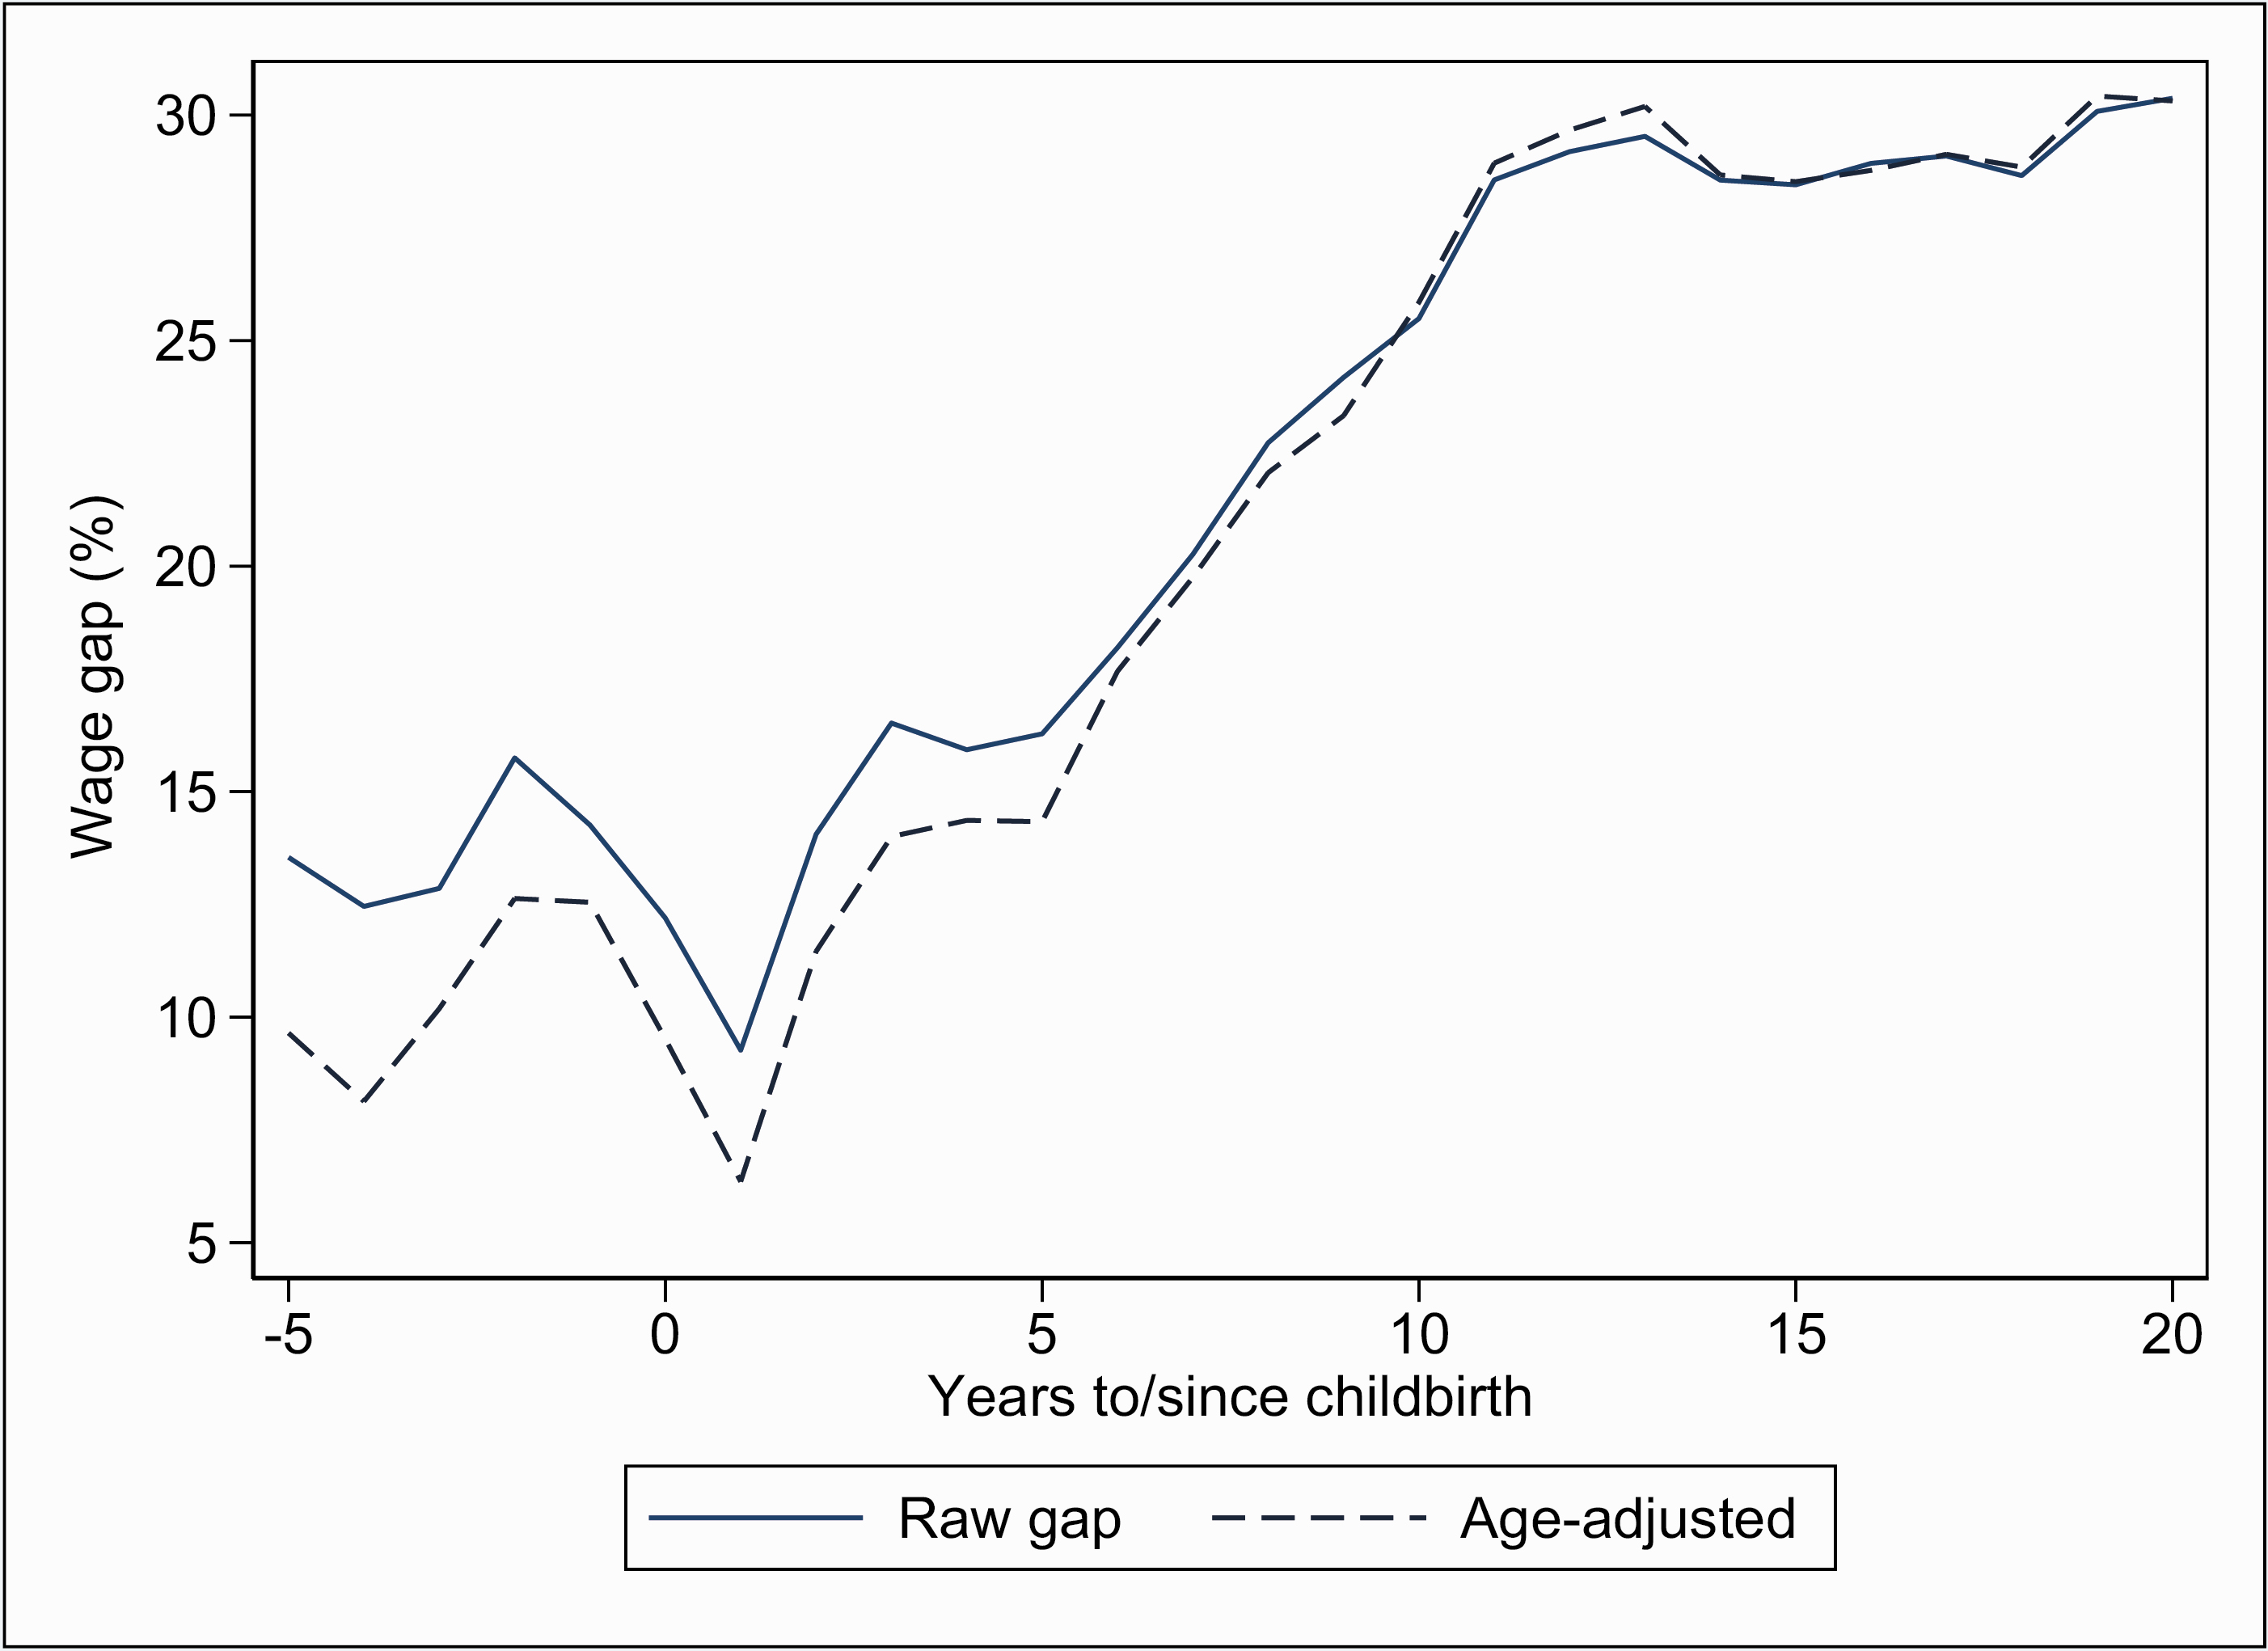
Gender wage gap by birth of first child in the UK
Source: Costa Dias et al. 2021 (https://doi.org/10.1093/oxrep/graa053). LFS 1993–2018. The gender wage gap is the percent difference in male and female average hourly wages.
Notes:
Gender wage gap by time to/since birth of first childNotes: UKHLS 1991 to 2017. Wage gap measured in proportion of male wages. Observations in the top one and bottom two percentiles of the wage distribution are excluded. The age-adjusted series shows the gap obtained from wage rates net of education-specific age effects.

Slide 27
Mainstream economics and market bias
“markets work efficiently and therefore … if some groups earn systematically less than others, it must be because they are less productive, or because they have chosen jobs that are more pleasant or flexible and therefore pay less” (Lundberg, p. 11)
For example:
  Care jobs pay less because they satisfy social/altruistic preferences (compensating differentials)
  Mothers are paid less because they choose flexible jobs or because they are less productive
  Women specialize in childcare and men in paid work because of comparative advantage (therefore maximize household welfare) (Becker)

Slide 28
Feminist interventions on debates on the gender gaps in the labor market:
  Compensating differentials vs. care penalties
  Human capital theory vs. devaluation of “feminine” jobs/tasks
  Specialization: “comparative advantage” or social norms?

Slide 29
“A woman would need to be over 100 times more productive in market work than her male partner before reaching expected parity in domestic work” (Siminski and Yetsenga 2022)
If specialization cannot be explained by comparative advantage, what role do norms and bargaining play?
How do these norms change?
Who should bear the costs of children?

Slide 30
This brings us back to how feminist economists think about unpaid care:
Is the cost of children a matter for policy – that is, should the state support parents?
Is raising children private consumption or a public good?
Beyond costs: does unpaid care contributes to living standards? If yes, how best to measure these contributions?

Slide 31
Unpaid work, income, and material living standards

Slide 32
Most measures of living standards use market incomes:
Consider two-adult families with two children in the U.S.: on average, dual-earner families earn $151,000 annually, compared to $130,000 for the single-earner ones
Yet the latter spend 44 hours more per week on household production.
Source: The Panel Study of Income Dynamics, 2017 and 2019. Household production defined as time devoted to housework, shopping, and childcare. Single (dual)-earner defined as only one (both) member(s) employed 40+ hours/week.

Slide 33
Unpaid work and inequality
(Women’s) unpaid work buffers income inequality across households:
Has unpaid work fallen over time as women take up paid work?
Are there differences in this decline across the income distribution?
Has women’s unpaid work also buffered the rise in inequality in the last 50 years?

Slide 34
Women’s paid work has risen
Source: CPS Annual Social and Economic Supplement (ASEC), ages 20-60.

Slide 35
Unpaid work has declined
Source: American Heritage Time Use Study (AHTUS) 1965-2018. Sample restricted to individuals aged 18+. See text for definitions of unpaid work, housework, and active childcare.

Slide 36
Extended incomes
How to account for unpaid work in a measure of material living standards?
Household production time (sum of all unpaid work by household adults) [valued at replacement wage]
Added to market incomes = Extended incomes
Mainstream alternative: Becker’s full income concept: all non-paid work time valued at the market wage rate.
See Jenkins and O’Leary (1995) for early discussion of extended income concept and estimates for the UK; Frazis and Stewart (2011) for estimates for the US.

Slide 37
Extended incomes rise slower
Source: American Heritage Time Use Study (AHTUS) for 1965-2018, and CPS ASEC 1968-2019. Market income and time devoted household production (valued at state-level minimum wages) are equivalized and expressed in 2018 dollars. Extended incomes are the sum of market income and the imputed value of time devoted to household production.

Slide 38
… and are less unequal

Slide 39
But inequality rise is higher.

Slide 40
Average extended income by household type
And some types of households do much worse …

Slide 41
Absence of a single, consistent data source to study the joint distribution of money and household production over time.
But trends across various (imperfect) sources point to similar conclusions:
  Inequality in extended income lower than for money income in the cross-section
  Decline in household production over time
  Equalizing effect has weakened
  Rise in inequality in extended incomes larger than for market incomes ...

Slide 42
Text sizes and hierarchy
A recap
What is unique about feminist economics?
Individual preferences shaped by norms, in turn the product of policies and collective action
Household decisions are the product of bargaining—power matters
Work includes unpaid and paid work
Important to measure and value unpaid work
Pluralism in methods

Slide 43
Text sizes and hierarchy with an image
Macro questions
Feminist macroeconomics
  Macroeconomic processes/policies have gendered impacts
  Care and national income accounting
  Integrating care into macroeconomic models
How to theorize economic crises and what prescriptions for policy?
  Gender-differentiated impacts of crises
  Feminist critique and alternatives for macroeconomic policy

Slide 44
Text sizes and hierarchy
A hypothetical scenario …
The UK government wants to direct public spending towards policies that will increase employment and economic growth. It considers cutting back on SureStart centres (public nurseries for children under 4) saving £5 billion a year. These funds are then spent on transportation infrastructure that will complement and increase private sector investment.
How do you think this would affect overall employment, female employment, and economic growth?
Notes:
2 specifically in the context of the crisis

Slide 45
Text sizes and hierarchy with an image
Feminist macroeconomic research
Addresses invisibility of unpaid care work in national income accounting
  Ignoring the value of unpaid work (as does GDP) misrepresents growth—misleading metric for policy choice
  E.g., overestimating production gains when women increase their labor force participation
  Recent SNA revisions include unpaid production of goods but not services.

Slide 46
Text sizes and hierarchy with an image
Feminist macroeconomic research (cont.)
Integrates care into macroeconomic models
  Care (also called social reproduction) is central to economic structures and processes, especially through role in the production and maintenance of the labor force
  In practice, integrating gender relations and the care sector into post-Keynesian models

Slide 47
Text sizes and hierarchy with an image
An example: Braunstein et al. (2011)
How do rising market participation and wages for women interact with economic growth?
It depends on:
how the income distribution influences aggregate demand
whether women’s rising market participation accompanied by greater sharing of unpaid work
  influences the production of human capital
  human capital enhances long-run production capacities and hence growth

Slide 48
Text sizes and hierarchy with an image
  Close links of feminist macroeconomics with post-Keynesian economics, but:
    both class and gender relations matter for effective demand, output, and growth
    recognizes supply-side constraints (via unpaid work and care) in addition to effective demand
    economic growth is not the only metric of assessing policy success—broader wellbeing matters
Notes:
Note overlap with human capital literature in mainstream economics: As such, investing in human capital is akin to investing in physical capital: one can invest in the human factor of production with the expectation of economic returns just as one can invest in the factor of production physical capital.1 Moreover, since human capital includes “education, training, medical care, and other additions to knowledge and health”, any policy affecting these areas affects human capital and, ultimately, growth.

Slide 49
Text sizes and hierarchy with an image
Note mainstream overlap
  “Human capital includes education, training, medical care, and other additions to knowledge and health …” (Gary Becker, Nobel Prize Lecture: “The Economic Way of Looking at Life”, 1992)
  “… investing in human capital is akin to investing in physical capital … one can invest in the human factor of production with the expectation of economic returns just as one can invest in the factor of production physical capital.”
  (Flabbi and Gatti, A Primer on Human Capital, World Bank Policy Research Paper, 2018)
  But key differences remain.
Notes:
Early childhood education and health only received focus in mainstream recently. Feminist concept borrows more from Sen’s human capabilities—broader, includes emotional skills, social trust, and community wellbeing. Feminist economics also sees GDP/growth metric as fundamentally wrong for policy choice. Argues that human capital not necessarily chosen (e.g., educated) and from private sector, but also provided through care from families (altruistic preferences, primarily women) or the state (public provision, institutions). Human capital a social/public good rather than a private one.

Slide 50
Text sizes and hierarchy
Crises and women’s employment
The initial impacts of the GFC (2008-2010) hit male employment much harder in both the U.K. and the U.S. In contrast, we observe the reverse during the 2020-2021 economic downturn, with women’s employment declining by as much—or more—than men’s employment.
Why do you think this was the case?
Notes:
2 specifically in the context of the crisis

Slide 51
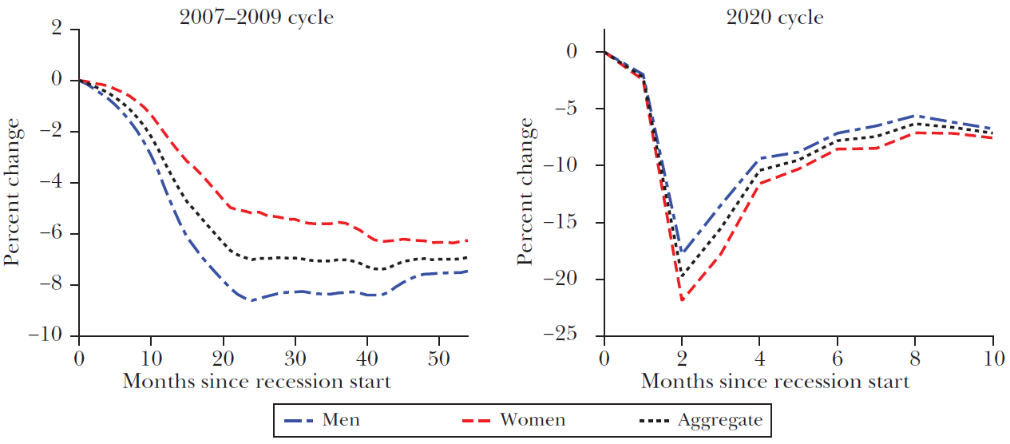
Text sizes and hierarchy with an image
Employment rate in the U.S. for GFC- vs. COVID-induced economic crises
Source: Albanesi and Kim (2021).
Notes:
From cause to consequences

Slide 52
Text sizes and hierarchy with an image
Feminist economists argue that:
Crises have uneven impacts across sectors
Gender segregation of jobs across sectors may either protect or expose women to job loss
Women’s job loss also depends on the nature of the economic shock and the policy response that follows
Notes:
Initial impacts of the crisis (2008-2010): higher rise in male compared to female unemployment in the U.K. (sectoral impact greatest on male-intensive industry and construction)
However, after 2010, male unemployment falls while female unemployment continues to rise in the U.K.; linked to cuts in public services (female-dominated public service employment)
Job creation favored men in the U.K.: for every 100 new jobs created after the crisis, only 37 went to women (Women’s Budget Group 2013)

Slide 53
Text sizes and hierarchy with an image
On macroeconomic policy
“Feminist economics … shows that decisions about economic policies, including determination of where investment is increased and where it is withdrawn, which services will flourish and which will be run down, and whose living standards will be protected or boosted, and whose reduced, are not gender neutral, even though they may make no explicit reference to gender.”
(Elson and Pearson, 2015; see also analysis by the U.K. Women’s Budget Group)

Slide 54
Text sizes and hierarchy with an image
Feminist critique of macroeconomic policy
Policy metrics focused narrowly on GDP/economic growth (exclude social and ecological concerns)
Austerity policies (e.g., 2010-2013 in the U.K.) with detrimental impacts on both social reproduction/care provision and gender equality
Public investment focuses on physical infrastructure (communication, transport, utilities) over social infrastructure (education, health, and social care classed as “consumption”)
Notes:
Social infrastructure classified as consumption rather than investment.

Slide 55
Text sizes and hierarchy
Mapping the origins of feminist economics
1960s: the rise of Becker’s New Home Economics
1970s: feminist critiques of mainstream treatments of labor market discrimination and household division of labor
1980s: feminist critique (of mainstream theory and method) consolidates
1990s: institutional home: International Association For Feminist Economics (IAFFE) formed in 1992; Feminist Economics journal 1995
Influences
Marxist political economy and socialist feminist critiques of Marx
Capabilities tradition (Sen, Nussbaum)
Intersectionality
Institutional economics (Veblen)

Slide 56
Thanks!
Questions?
Also email me: l.gautham@leeds.ac.uk

