Slide 1
An Introduction to Post-Keynesian Economics
Annina Kaltenbrunner
University of Leeds

Slide 2
Post-Keynesian Economics: Development
After publication of General Theory discussion on interpretation of Keynes’ theory (e.g. involuntary unemployment, financial crisis)
  Hicks develops ISLM/Neoclassical-Keynesian Synthesis, later New Keynesian Econ
  PKE emphasises break of Keynesian theory from neoclassical theory - Reject need for microfoundations of macroeconomics
Developed by the collaborators of Keynes (Joan Robinson, Kaldor, Kahn; Kalecki)
Initial project: turn Keynes’ theory from a short run theory to longer term theory
  Develop a Keynesian growth theory
  Criticise neoclassical theory of income distribution (Cambridge Capital Controversies)
School formation in 1970s
  Term first mentioned by Eichner and Kregel in 1976
  Foundation of Journal of Post-Keynesian Economics in 1978

Slide 3
Post-Keynesian Economics: Development and Streams
70s + after: spreading out (USA, cont. Europe)
  Conflict inflation
  Endogenous money (Structuralists vs. Horizontalists)
  Shift towards short/medium run analysis (Kaleckian models): distribution and demand
  Financial instability (Minsky)
  More on economic policy, more empirical
Streams
  Monetary Keynesians (incl. Minsky)/Fundamentalists: uncertainty, money, short term
  Kaleckians: social conflict, distribution, demand; short/medium term
  Sraffians: long run, distribution, technology and prices
  Kaldorians: endogenous technological progress
  Institutionalists
  Various other (often narrower) streams: Latin American Structuralism/Balance of payments constrained growth, Modern Monetary Theory (MMT)
Notes:
Famous Sraffians: Luigi Pasinetti, Pierangelo Garegnani, Geoffrey Harcourt, Heinz Kurz, Franklin Serrano

Slide 4
Post-Keynesian Econ
PKE
Kalecki: wage-led growth
Minsky: financial cycles
Kaldor: endogenous tech progress
Keynes: effective demand, multiplier, involuntary unemployment

Slide 5
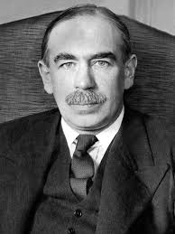
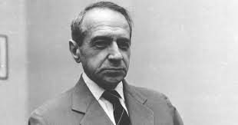
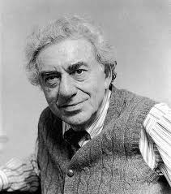
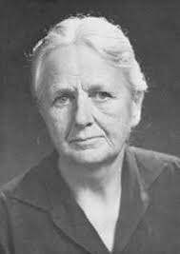
Outline
Comparison to other schools of thoughts
Foundations
  Fundamental uncertainty
  Social conflict, heterogeneity, and institutions
  Effective demand
Macroeconomics
  Investment → savings
  Involuntary unemployment
  Credit → money
  Financial instability
  The supply side: hysteresis and cumulative causation
Outcomes:
  Some paradoxes
  Economic Policy
Current debates: International Financial Subordination
Notes:
In the Post-Keynesian tradition, effective demand is the foundational macroeconomic principle that aggregate spending—not the supply of labor or capital—determines the actual level of output, income, and employment in both the short and long run
It flips the classical "Say's Law" (that supply creates its own demand) on its head, meaning that economic activity is strictly demand-determined
No Automatic Full Employment: Unlike mainstream neoclassical models that assume markets perfectly clear to guarantee full employment, Post-Keynesians argue that effective demand frequently settles at a point of involuntary unemployment and idle productive capacity. The economy can be stuck in a sub-optimal equilibrium because expected demand is simply not high enough to warrant full employment. [1, 2]

Slide 6
Comparison to other schools of thoughts
Schools of thought in macroeconomics
Marx
Keynes
Neoclassical
Post-keynesians
Synthesis Keynesians
New Classcial Econ
Monetarism
Rational Expectations
RBC
New Keynesians
Notes:
Estranged cousins of PKE
reaction to New Classicals - accept microfoundations and often rational expectations
but assumes (or derives) imperfect markets –
menu costs,
NAIRU, insider outsider models
credit rationing / asymmetric information
in 1980s: many partial equilibrium models (Mankiw, Blanchard, Stiglitz, Fisher)
1990s: “New Consensus Model” (New Keynesian-Neoclassical Synthesis) and DSGE
short run/long run dichotomy, but with strict microfoundations
Pseudo IS curve: downwards sloping because of intertemporal consumption
Since 2008: rediscovering PK arguments: hysteresis, financial instability

Slide 7
Keynesian vs. Neoclassical Theory
 | Neoclassical theory | Keynesian theory
Key concepts | Rational behaviour, equilibrium | Effective demand, ‘animal spirits’
Behaviour | Rational behaviour by selfish individuals | ‘animal spirits’ (non-rational behaviour) and conventional
Markets | Market clearing ← price adjustment | Some markets don’t clear
Money | Classical dichotomy (money is neutral) | Endogenous money creation Endogenous financial instability; money non-neutral
Unemployment | Voluntary or due to rigidities | Involuntary, due to lack of demand on goods markets
Policy | Laissez faire: markets are self-regulating and government should not intervene | market economies are unstable and result in unemployment → government should intervene

Slide 8
Keynesian vs. Marxian Theory
 | Post-Keynesian | Marxian Economics
Scope | Economic theory | Part of richer, interdisciplinary project (Historical Materialism)
Demand | Effective demand | Often assumes Say’s law; demand (‘realisation crisis’) only in short run
Production | Little to say about production | Production as labour process
Class analysis | Classes have different consumption propensities; only capitalists make investment decisions | Class struggle at site of production Class struggle -> theory of state
Money & finance | Money is created by banks as side effect of lending Money to deal with uncertainty | Commodity theory of money: money is produced commodity
Unemployment | Lack of effective demand; no tendency to full employment | Industrial reserve army necessary to discipline workers
Policy | Normative: full employment policy; can also benefit capital | Reform futile within the capitalist system

Slide 9
Fundamental uncertainty
Foundations of Post-Keynesian Economics
Effective
demand
Classes +
institutions

Slide 10
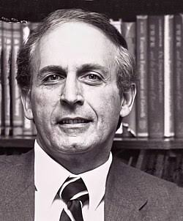
Foundation 1: Fundamental Uncertainty
‘we simply don’t know’ - World is “non-ergodic” – no measurable
distribution functions
→ animal spirits: people can’t be ‘rational’, instead
  They rely on conventions (heuristics)
  Look what other people are doing (beauty contest, social norms)
  Conventions can change rapidly (herd behaviour) – inherent instability of capitalist economies
Institutions emerge to deal with uncertainty - Money as a means to deal with uncertainty → liquidity preference
  Possibility of liquidity crises and panic
Investment demand driven by animal spirits – instability of capitalism
  Can’t make a ‘rational’ decision about long time horizon

Slide 11
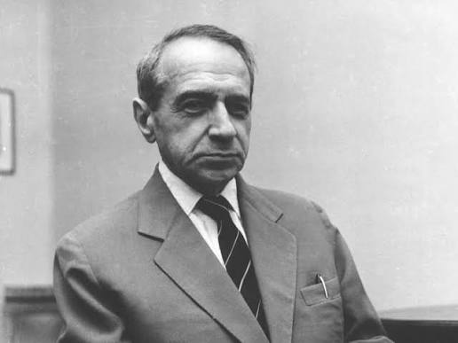
Foundation 2: Classes, Social Conflict, and Institutions
PKE in political economy tradition: class analysis instead of
methodological individualism
  Social conflict: classes, gender, … heterogeneity
  Heterogeneity: both in expectation formation and in social class
PK models: often 3 classes: workers, capital, rentiers/finance
  Capital hires labour and makes investment decisions (determines profits)
  Rentiers advance capital and receive interest + dividend payments
  Workers consume most of their income
  Have different consumption propensities – distribution matters for macroeconomic dynamics!
Institutions regulate and mediate conflicts
Inflation as the outcome of unresolved distributional conflicts
Notes:
Workers: Kalecki assumed that workers spend all of their income on basic goods (their marginal propensity to consume is practically 1). Consequently, workers generate almost no savings. [1, 2, 3]Capitalists: Capitalists receive profit income and have a higher capacity to save. Their consumption is a function of their profits (a fixed baseline plus a fraction of realized profits)
The most famous application of consumption propensities in Kalecki's model is his profit equation. Rather than income depending on savings, Kalecki argued that causality runs in reverse. In a simplified economy, the volume of gross profits (\(P\)) equals the sum of gross investment (\(I\)) and capitalists' consumption (\(C_{K}\)): [1, 2, 3, 4]
\(P = I + C_K\)
Because workers do not save, any money capitalists spend on investments or luxury consumption flows right back into the economy as profits. Therefore, the consumption propensity of capitalists is the main engine that realizes aggregate profits

Slide 12
Foundation 3: Rejection of Say’s Law and Effective Demand
Output and growth are determined by aggregate demand, and thus adjust towards the latter, in the short and in the long run
Y=C+I+G+(X-M)
Aggregate demand can fluctuate
Multiplier Process
  Initial change in spending can lead to a larger overall change in aggregate demand and GDP (e.g. fiscal multiplier)
Notes:
Say’s Law: supply creates its own demand

Slide 13
Macroeconomic Dynamics 1: Investment creates Savings
Investment creates savings via the multiplier process
  Investment determined by forward looking expectations
  Not constrained by savings but potentially by the availability of finance
  Strong non-rational argument – animal spirit and conventions – weak impact of interest rate changes
  Single most important determinant of GDP fluctuations
Savings is passive, but
  Different saving propensities of classes (Kalecki) – wage-led vs. profit-led demand
  Possibility of wealth effects in consumption
Private goods market equilibrium will in general not be at a full employment equilibrium
>> Fiscal policy will be highly effective, in particular in times of financial crises

Slide 14
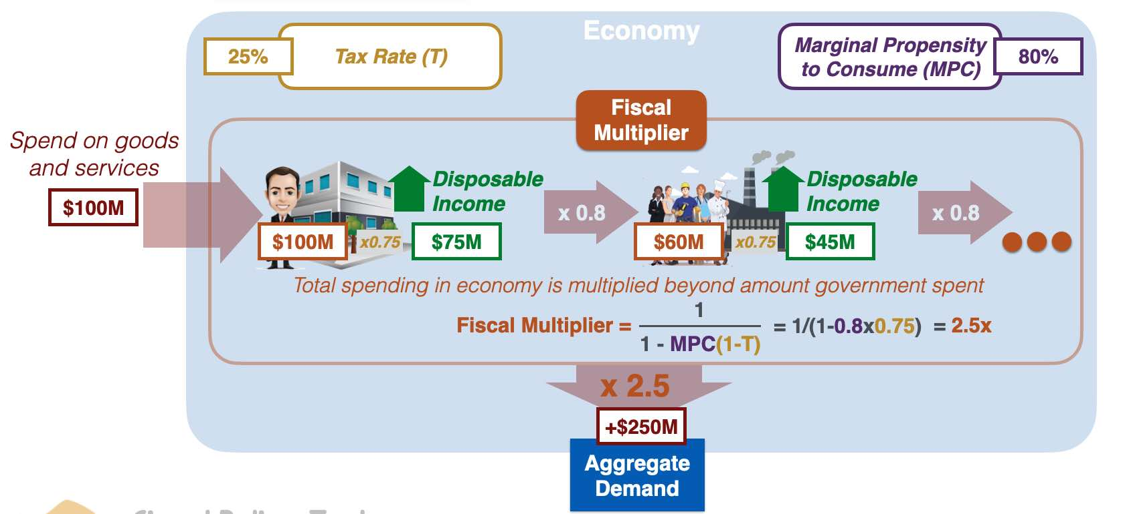
Investment creates Savings through the Multiplier
Source: https://prepnuggets.com/glossary/fiscal-multiplier/

Slide 15
Macroeconomic Dynamics 2: Involuntary Unemployment
Refers to a situation where individuals are willing and able to work at the prevailing wage rate but cannot find jobs due to insufficient aggregate demand.
Wage cuts → reduction in consumption demand
  → downward pressure on prices
  → possibility of debt-deflation spiral
Real wage cut: workers have higher marginal propensity to consume than capitalists
  → real wage cut will be contractionary unless investment is very sensitive to profit margins
Labour market dragged along with goods market; strong hysteresis
Notes:
Unemployment in neoclassical economics due to wage rigidity
Workers may resist nominal wage cuts. Wages are ‘sticky downwards’.
If firms did manage to cut wages, this would lead to a further fall in consumer spending and aggregate demand, causing more unemployment
Negative multiplier effect. A rise in unemployment will cause a fall in consumer spending and therefore further cause a rise in unemployment.
Furthermore, a rise in unemployment can adversely affect consumer confidence and consumer spending. The fear of unemployment can cause a rise in savings which further reduce economic growth. Keynes referred to this as a paradox of thrift.
Hysteresis: the economic theory that temporary periods of high unemployment can cause permanent, long-term damage to the workforce. It means that even after an economic recession ends and business conditions recover, the unemployment rate fails to return to its pre-recession baseline

Slide 16
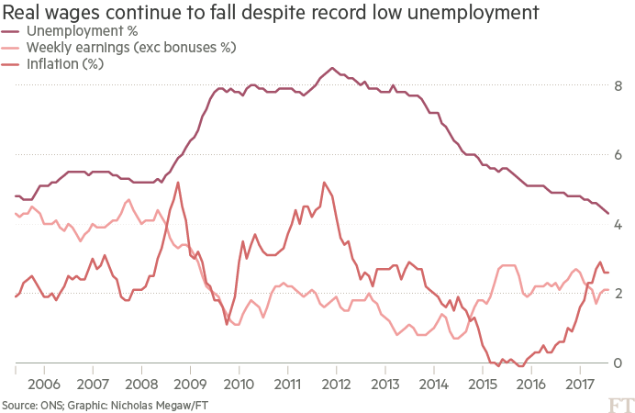
Macroeconomic Dynamics 2: Unemployment
Source: https://thenextrecession.wordpress.com/wp-content/uploads/2017/09/uk-employment.png

Slide 17
Macroeconomic Dynamics 3: Monetary production economy and endogenous money
Interest rate not a real variable but determined by demand for money to protect against fundamental uncertainty – Liquidity preference theory
Interest rates (on bonds) increase when uncertainty/demand for money increases
  Transaction, Precautionary, and Speculative motive to hold money
  Extension of liquidity preference theory as a general theory of portfolio choice (Chapter 17 of the General Theory)
Endogenous Money
  Money supply not determined by the central but the “private” banking system
  CB sets the interest (base) rate - Private financial institution mark up according to their liquidity preference (risk premium) – Structuralists vs. Horizontalists
  Loans create deposits
Elastic finance allows for investment booms as well as for speculative asset price booms > instability of a financially sophisticated capitalist economy

Slide 18
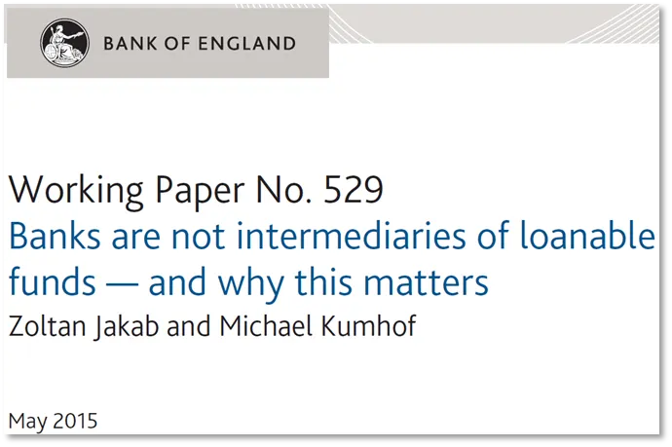
Macroeconomic Dynamics 3: Monetary production economy and endogenous money

Slide 19

Macroeconomic Dynamics 4: Inherent and endogenous instability of financially sophisticated capitalist economy
Keynes: theory of financial crisis, collapse of confidence, rush to safety (liquidity preference)
Hyman Minsky develops this into a theory of endogenous financial cycles
  Mainstream (DSGE) financial crises due to exogeneous shocks
Minsky incorporates financing/liability side into Keynesian theorising
Three financing units: hedge, speculative, Ponzi
Minsky’s theory of financial instability
  Financing units move from hedge to speculative and Ponzi during the course of the business cycle
  Endogenous shock makes fragile financing units unstable
  Selling of assets and debt deflation – financial crisis
  Big government and big central bank

Slide 20
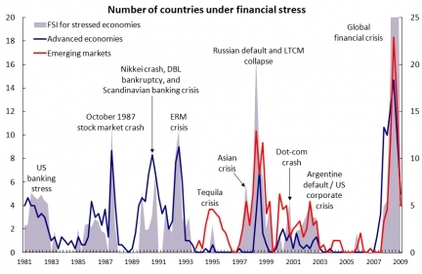
Inherent and endogenous financial fragility and instability
https://seekingalpha.com/article/224685-charting-banking-xix-history-of-financial-crises

Slide 21
Macroeconomic Dynamics 5: The supply side: Hysteresis and Cumulative Causation
Economy demand-led even in long run (neoclassical: “medium-run”)
Supply adjusts to demand shocks
> Unemployment Hysteresis
  endogenous NAIRU; endogenous labour supply
> Endogenous Labour Productivity – Cumulative Causation
  induced technical change; dynamic returns to scale (learning by doing), Kaldor-Verdoorn effects
Balance of Payment constraint growth models (Thirlwall): Long-term growth determined by export and import elasticities
Risk of secular stagnation

Slide 22
Outcomes: Paradoxes of market economies
Market economies do not gravitate towards full employment equilibrium
Paradox of thrift (Keynes): increase in individual saving propensities can lead to decline in aggregate saving
Paradox of cost (Kalecki): increase in wage can lead to increase in profits (“wage-led demand regime”)
Paradox of debt (Steindl, Koo): attempt by firms (indebted units) to reduce leverage can lead to depression and thus rising debt ratios
Paradox of tranquillity (Minsky): stability breeds instability as it encourages more risky behaviour
Long-lasting demand shocks, Possibility of ‘secular stagnation’

Slide 23
Outcome: Economic Policy
 | Mainstream Policy Mix | Post Keynesian Policy Mix
Overall aim | Efficiency (minimal interference in markets) | Full employment
Fiscal policy | Balanced budgets (‘sound fiscal policy’) | Countercyclical fiscal policy to ensure full employment
Monetary policy | Inflation targeting | Has to support growth; In recession with debt hangover: higher inflation to simplify deleveraging
Labour market | Encourage ‘labour market flexibility’ Wage as a cost factor | Institution building Wages as source of demand
Financial market | financial liberalisation, trusts efficiency of financial markets | Regulation has to ‘lean against the wind’ (macroprudential policies)

Slide 24
Current debates in PKE
1980s/1990s
Endogenous money. Structuralists vs horizontalists
Fundamental uncertainty & methodology
Kaleckian models
Balance of payments-constraint growth
1990s/2000s
Demand regimes: wage/profit-led growth
Financialisation
SFC-modelling
MMT
2010s/current
Financial instability/Minsky
Ecological PK macro
Feminist PK macro
Sraffian Supermultipler (SSM)
‘International financial subordination’
‘Growth models: PKE and Comparative Political Economy
Income and Wealth Distribution

Slide 25
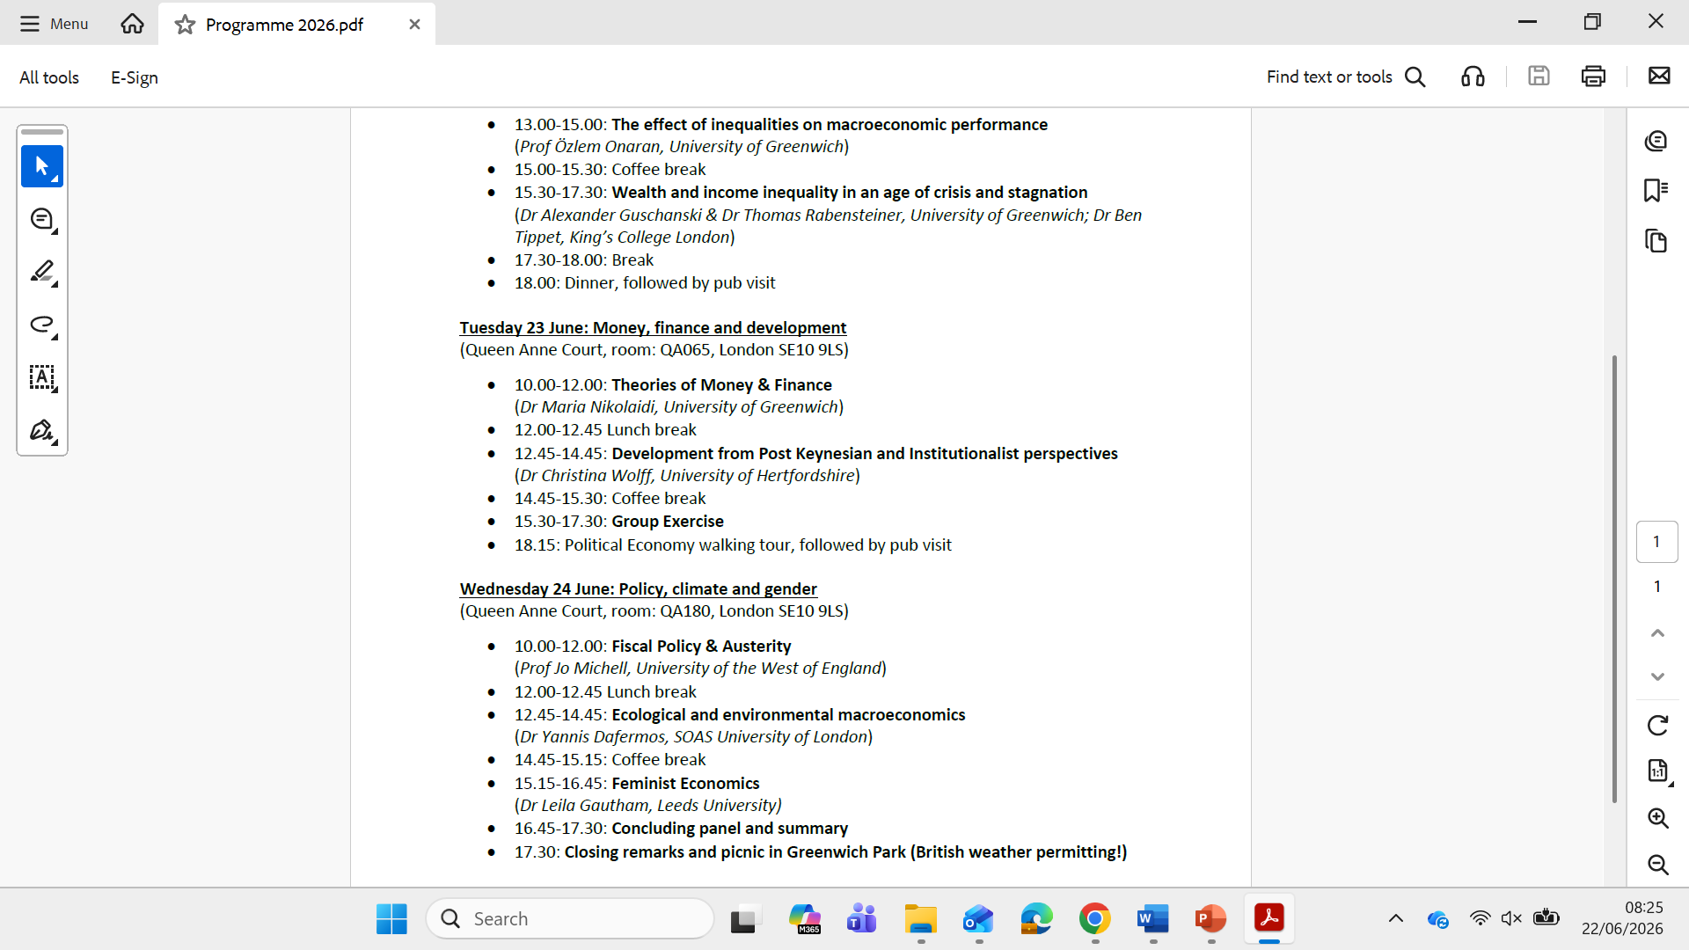
Current Debates

Slide 26
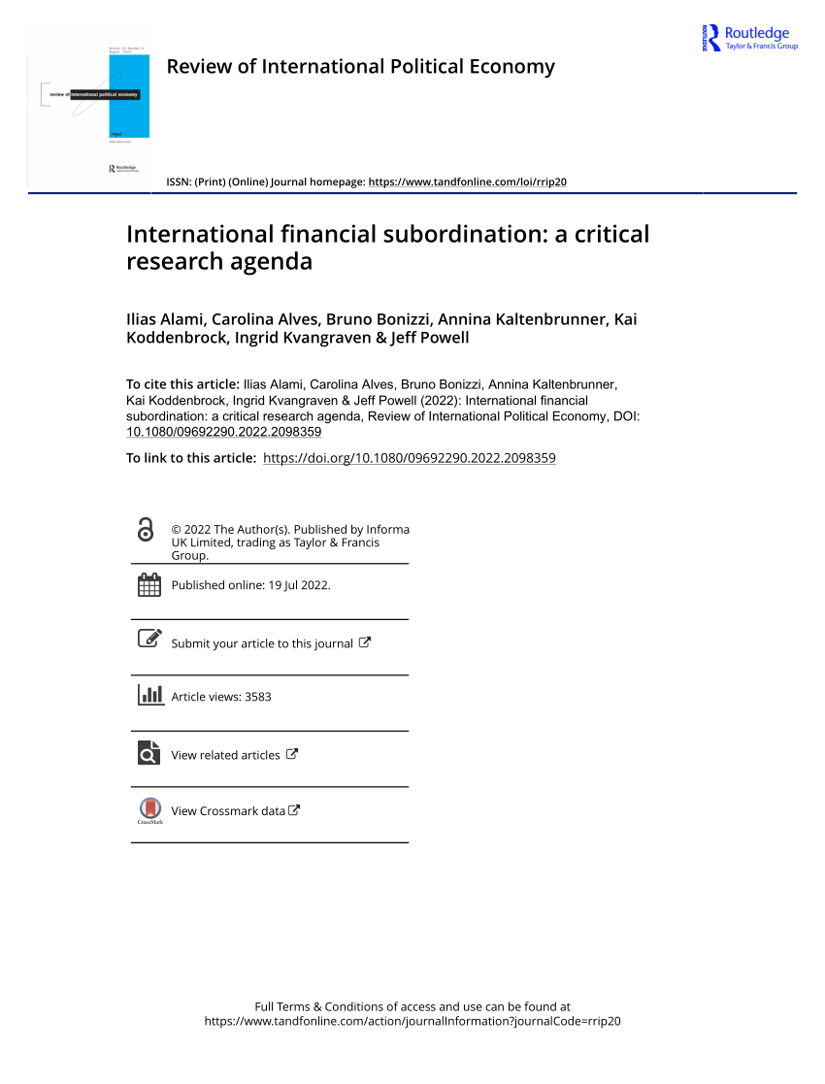
Current Debates: International Financial Subordination
By now established and large interdisciplinary body of literature on DECs’ international productive subordination under the umbrella of Global Commodity Chains/Global Value Chains/Global Production Networks
No unified literature which conceptualises monetary financial aspect of structural subordination in global capitalist system
Propose the concept of “International Financial Subordination
Initiate a critical and interdisciplinary research agenda which systematically engages with this structural financial subordination

Slide 27
Current Debates: International Financial Subordination
IFS suggests a relation that is both spatial and saturated with power, a relation of domination, inferiority and subjugation between different spaces across the world market, expressed in and through money and finance, which penalises actors in DEEs disproportionally.
It expresses itself as constraints on the agency of a multiplicity of social actors, it is directly implicated in the geographical transfer of value across the world market, and it significantly contributes to broader patterns of uneven spatial development.
Notes:
So how do we do that?

Slide 28
Current Debates: International Financial Subordination
Key features:
Structural: Subordination emanates from asymmetric productive and financial structure of global economy (production: sectoral specialisation and value added (GVCs/GPNs); financial: dollar dominance and financial centres) rather than domestic policy failures
Systemic: Subordination inherent part of global capitalism: creation, transfer, storage and realisation of value on the global scale (Bonizzi et al. 2022)
Foregrounds agency within structures- non deterministic > Variegation

Slide 29
Theoretical Underpinnings
Dependency Theory (e.g. : Prebisch, 1939; Nkrumah, 1965; Amin, 1974; Tavares, 1985)
Conceptual lens: Core-periphery relations; Historical approach to development; structures and tendencies of capitalism
Structural driver of IFS: Colonial systems of production and extraction that also impact the financial system in the periphery (e.g. foreign dominated banking systems; dominance of external conditions)
Main empirical manifestation: Actors in periphery pay higher prices for finance
Recent work: e.g. Koddenbrock et al. 2022; Musthaq, 2021, Khafagy, 2025)
Notes:
Say that dependency theorists are theoretically quite diverse; from LA structuralists to more Marxist scholars
A more contemporary
application of dependency theory is that of Musthaq (2021), who demonstrates
how Amin’s conceptualization of imperialist ‘labor arbitrage’ can be extended to
account for the hierarchical nature of global monetary and financial relations, creating
opportunities for imperial ‘financial arbitrage’. In a hierarchical monetary system
that privileges world money, the growing responsiveness of capital movements
to monetary policy in advanced countries worsens the situation for countries in a
subordinate monetary position in the global economy (see also Sylla, 2021; Reis &
Antunes de Oliveira, 2021).

Slide 30
Theoretical Underpinnings
2. Post-Keynesian Currency Hierarchy Theory (e.g. Belluzo and Carneiro, 2004; Riese, 2001; Prates and Andrade, 2013; Kaltenbrunner, 2015; Bonizzi, 2017)
Conceptual lens: Monetary hierarchies – Ability of domestic currencies to assume money functions in the international economy – international liquidity premium
Main driver of IFS: Balance of payments constraint and structure of global financial markets
Main empirical manifestation: External vulnerability, exchange rate volatility, higher interest rates
Recent work: Bonizzi and Kaltenbrunner, 2024; de Paula et al. 2025; Orsi et al. 2026

Slide 31
Theoretical Underpinnings
3. Marxist Theories (classic theory of imperialism: Luxemburg, Lenin, Hilferding; Becker et al. 2010; Painceira, 2012; Powell, 2013; Alami, 2019)
Conceptual lens: Class conflict and imperialism
Main driver of IFS: Coerced integration into world market and interest of finance capital
Empirical manifestation: Sustained value transfer from core to periphery and squeezing of working class to ensure stable integration into world market
Recent work: e.g. Lapavitsas, 2026; Alami, 2025
Notes:
Coercive integration here refers to a broad set of both historical and
more contemporary processes of imperialism, such as colonization, structural
adjustment programs, free trade agreements and various other forms of extra-economic
pressure.

Slide 32
Current Debates: Currency Hierarchy and International Financial Subordination
Application of Keynes’ liquidity preference theory and “own rate of return” to the open economy and international currencies
One currency (currently the US Dollar) is the money of the system and demand/returns of other currencies are determined vis-à-vis that currency > hierarchy of currencies
  Currencies lower down the hierarchy need to offer higher returns to compensate for lower liquidity premium
  Currencies lower down the hierarchy are more sensitive to changes in international liquidity preference (the global financial cycle)
  Currencies lower down the hierarchies need to engage in macroeconomic, regulatory, and institutional practices to increase the “liquidity” of their currencies (e.g. reserve accumulation, “de-risking” state action; capital account deregulation; financial market development etc.)
Currency hierarchy as PK leg of International Financial Subordination research agenda

