Slide 1
Adding your title
Feminist Economics
Leila Gautham
University of Leeds
PKES Summer School 2026
June 24

Slide 2
Text sizes and hierarchy
What is feminist economics?
Studies gender roles in the economy; recognizes that gender matters for economic processes/outcomes
Studies biases in the content and methodology of the economics discipline
Studies social provisioning
    Processes and resources that individuals and communities need, in order to survive and flourish, even if not mediated by the market.

Slide 3
Text sizes and hierarchy
Starting points
Economic activity includes market/paid work and unpaid work
Interaction between individual preferences and behavior, social norms, and policies
Economic outcomes & processes shaped by gender, which intersects with other social identities
Human well-being (not income) the yardstick of economic success
Pluralism in methods and models

Slide 4
Text sizes and hierarchy
Mapping the origins
1960s: the rise of Becker’s New Home Economics.
1970s: feminist critiques of mainstream treatments of labor market discrimination and household division of labor.
1980s: feminist critique (of mainstream theory and method) consolidates.
1990s: institutional home: International Association For Feminist Economics (IAFFE) formed in 1992; Feminist Economics journal 1995.
Influences
Marxist political economy and socialist feminist critiques of Marx
Capabilities tradition (Sen, Nussbaum)
Institutional economics

Slide 5



Text sizes and hierarchy
This is what a feminist economist looks like. Photo series by Stephanie Seguino (http://www.stephanieseguino.com/this-is-what-a-feminist-economist-looks-like.html)

Slide 6
Text sizes and hierarchy
Mainstream economists also now work increasingly on gender and families.
Where do feminist economists differ from mainstream perspectives?
Defining work
Measuring and valuing economic activity
Conceptualizing the individual
Modelling household decisions
Methods
(And from other heterodox approaches.)

Slide 7
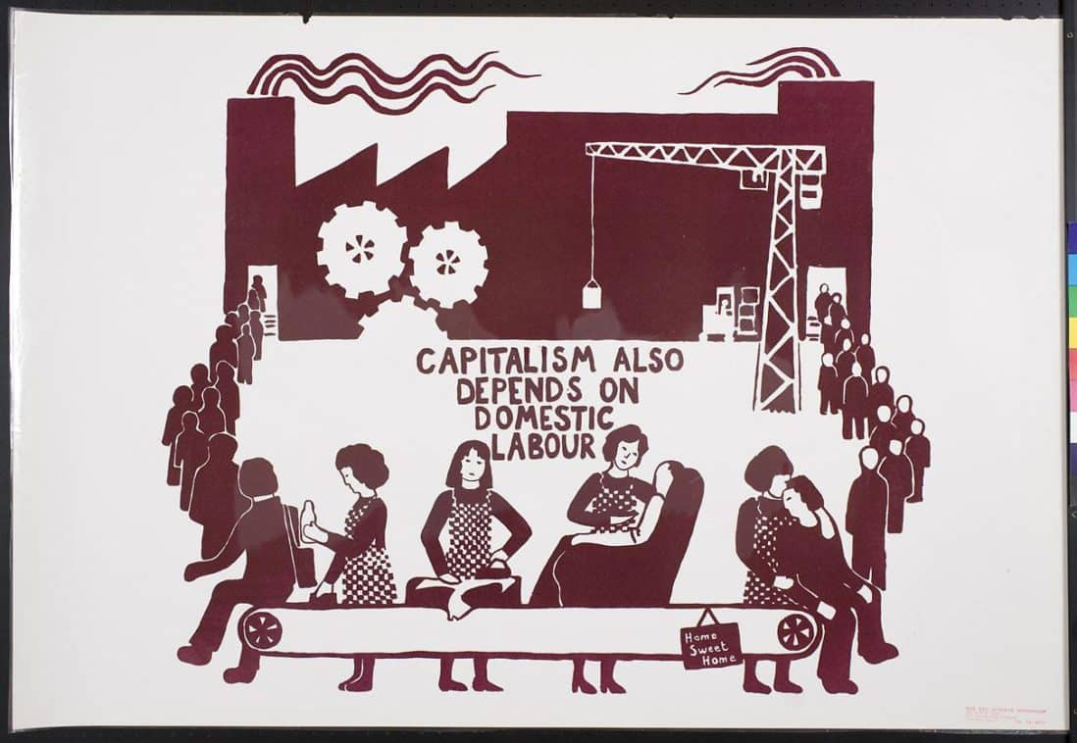
Text sizes and hierarchy
I. What is work?
Source: Red Women’s Workshop © 2019 Oakland Museum of California.

Slide 8
Text sizes and hierarchy
Defining work
Unpaid work (housework or caring for children and other dependents) usually not included in economic definitions of “work.”
What is work?
Mainstream: work as disutility, requires compensation or income (work = paid work)
Feminist: any activity that one could, in principle, pay someone else to do (work = paid + unpaid work)
[also known as the third-party or Reid criterion]

Slide 9
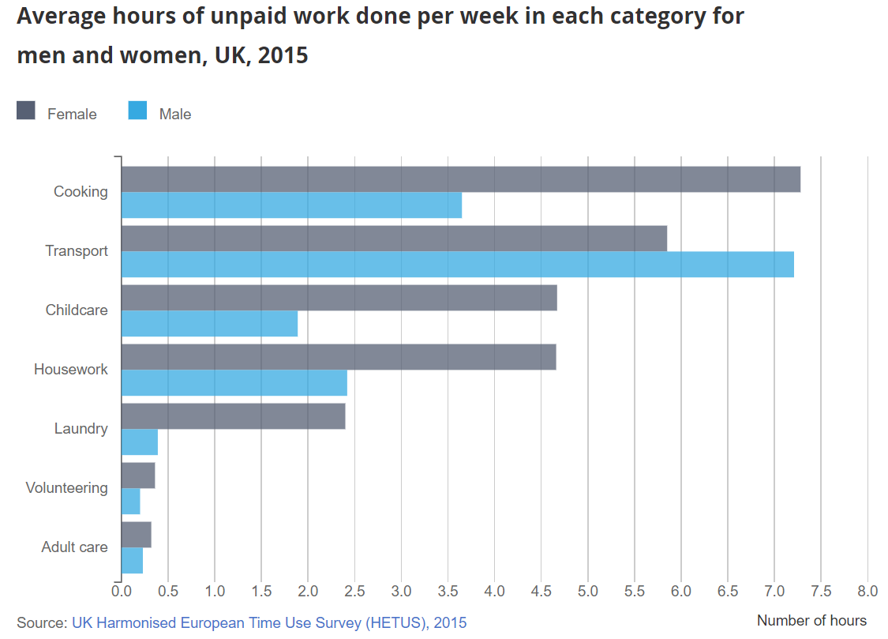
Text sizes and hierarchy
What is at stake?
Source: “Women shoulder the responsibility of 'unpaid work'.” ONS 2016. shorturl.at/lqAZ7. Men do about 16 hours of unpaid work a week, on average, while women do 26.
Notes:
On average men do 16 hours a week of such unpaid work, which includes adult care and child care, laundry and cleaning, to the 26 hours of unpaid work done by women a week. The average man would earn £166.63 more per week if his unpaid work was paid, whereas the average woman would earn £259.63 (using 2016 data on earnings).

Slide 10
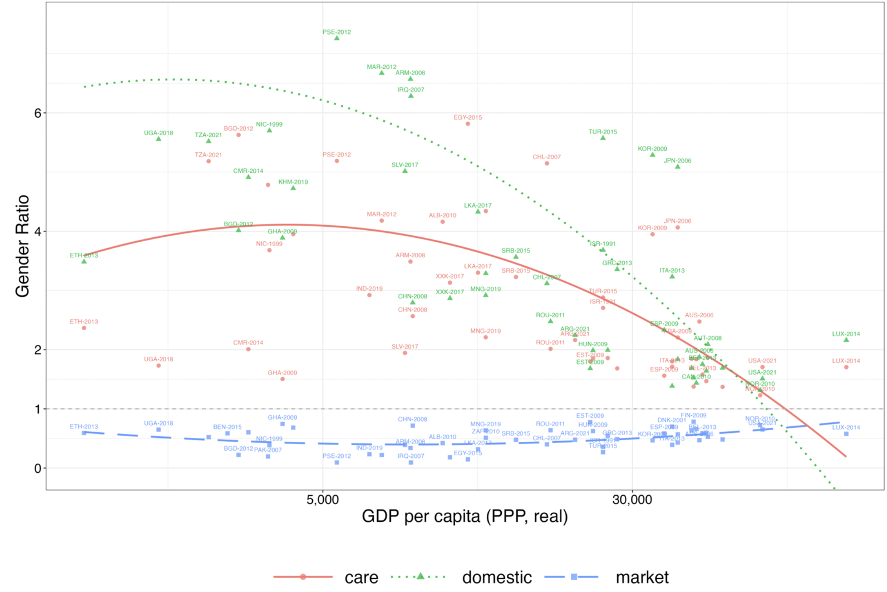
Text sizes and hierarchy
Gender gap (ratio) in hours worked
Source: Gottlieb, Doss, Gollin, and Poschke 2024. The gender division of work across countries.
Notes:
On average men do 16 hours a week of such unpaid work, which includes adult care and child care, laundry and cleaning, to the 26 hours of unpaid work done by women a week. The average man would earn £166.63 more per week if his unpaid work was paid, whereas the average woman would earn £259.63 (using 2016 data on earnings).

Slide 11
What is at stake? (cont.)
Most measures of living standards use only incomes from paid work:
Consider two-adult families with two children in the U.S.: on average, dual-earner families earn $151,000 annually, compared to $130,000 for the single-earner ones
Yet the latter spend 44 hours more per week on unpaid work.
Source: The Panel Study of Income Dynamics, 2017 and 2019. Household production defined as time devoted to housework, shopping, and childcare. Single (dual)-earner defined as only one (both) member(s) employed 40+ hours/week.

Slide 12
Ought we to quantify the value to unpaid work?
Why? (Or why not?)
How would you value an hour of unpaid work?

Slide 13
Text sizes and hierarchy
II. Measuring economic activity
Existing measures of economic activity (e.g., GDP) value unpaid work at zero.
Unpaid work contributes to living standards.
    Resistance: “enjoyment” (but diff from q. of value)
It also helps generate human capabilities, intrinsically valuable but also important for economic growth.
Principles of valuation (see Folbre 2015 on reading list): replacement vs. opportunity costs.

Slide 14
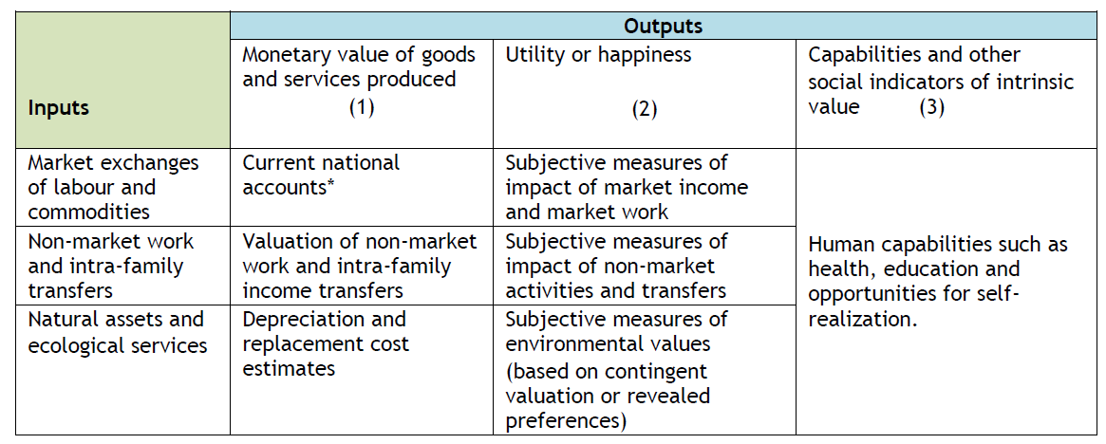
Text sizes and hierarchy
Measuring economic activity (cont.)
GDP
Source: Folbre (2015)
Environmental-Economic Accounting
Household satellite accounts

Slide 15
Text sizes and hierarchy with an image
Feminist interventions
Addresses invisibility of unpaid care work in national income accounting.
  Ignoring the value of unpaid work (as does GDP) misrepresents growth—misleading metric for policy choice.
    E.g., overestimating production gains when women increase their labor force participation
  2025 SNA: Recommends construction of satellite accounts for household production (every 5 years).
  Measures implicit income from unpaid household services.
  Structural changes between paid and unpaid work.
  Time allocation.

Slide 16
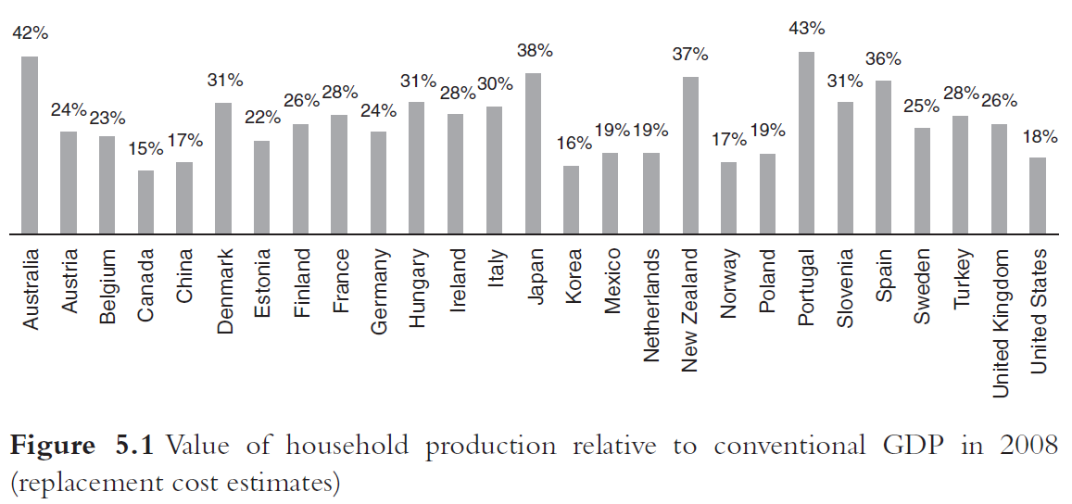
Text sizes and hierarchy
The value of household production
Source: Fischer et al. Rethinking Economics, chapter 5. “Feminist Economics”

Slide 17
Text sizes and hierarchy
III. Thinking about the individual
Homo economicus or the “economic man” of neoclassical economics: independent decisions and exogenous, self-interested preferences.
  Self-interest vs. altruism (market vs. family)
  Recent mainstream work on gender: preferences vs. discrimination dichotomy (see Lundberg 2023 for an excellent critique)
  For example: women have lower pay because they “choose” occupations that satisfy their “preferences” for helping others.

Slide 18
Text sizes and hierarchy
Why does this framing matter?
Feminist economists emphasize a historically specific analysis that is attentive to social structures.
    Preferences influenced by social norms
    Social norms themselves are the product of collective action and policy
  See England 2005 on the reading list for feminist theories of care.

Slide 19
Text sizes and hierarchy
IV. Modelling households
Gary Becker’s A Treatise on the Family (1991) extends neoclassical economics/rational choice theory to families
Unitary decision-making: altruistic [male] household “head”
Efficient outcomes
Feminist economics: household decisions formed by bargaining between family members
Fallback positions (power) matter for household outcomes
Inefficient outcomes are possible
Empirical evidence: intrahousehold distribution of consumption depends significantly on which household members receive or control income.

Slide 20
Text sizes and hierarchy
Household bargaining in feminist economics
Household decision making
Paid labor supply and unpaid work of household members; fertility; resource allocation and consumption; intra-household wellbeing
Assets (wealth, land, social capital)
Bargaining power (weight placed on individual’s preferences and wellbeing)
Fallback position (individual’s position if household relations breaks down)
Social norms (gender roles, traditions)
Social institutions and state policies

Slide 21
Text sizes and hierarchy
V. Methods
Mainstream claim: detached, value-free, rigorous empirical methodology
Feminist economists contest this claim to neutrality;
    critique devaluation of alternative models and methods and mainstream emphasis of rigor over social relevance
Instead:
Qualitative methods, archival research, mixed methods
(see Kabeer 2020 on reading list)

Slide 22
Bringing together debates between feminist and other economists on work, care, preferences, and families:
the gender wage gap …

Slide 23
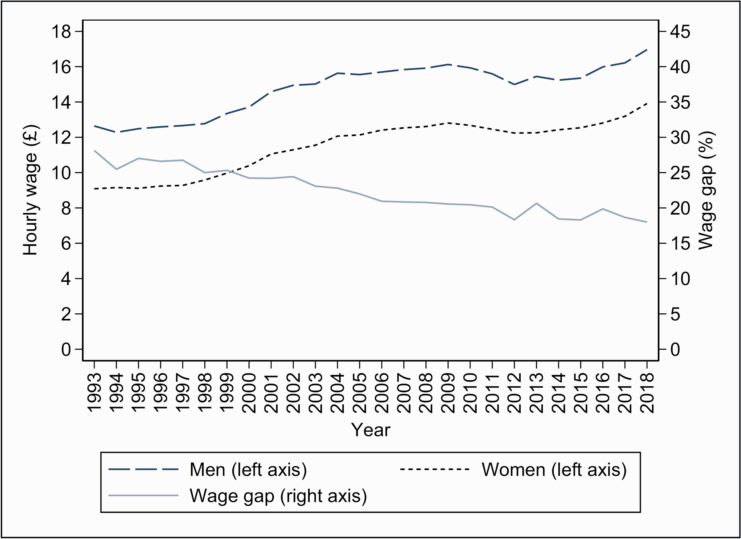
The gender wage gap in the UK
Source: Costa Dias et al. 2021 (https://doi.org/10.1093/oxrep/graa053). LFS 1993–2018. The gender wage gap is the percent difference in male and female average hourly wages.
Notes:
The gap has decreased over the last 20 years from almost 30 per cent in 1993. Currently, the average female employee earns around a fifth less per hour than the average male employee. It is not a ‘like-for-like’ comparison between otherwise-identical workers or jobs. One reason why wage differentials between men and women might have changed over this period is that their relative levels of education have also changed. This is actually an important aspect to take into account in interpreting the declining wage gap over time. The increase in education was faster for women, who overtook men by the late 2000s and are now more likely than men to have a university degree.

Slide 24
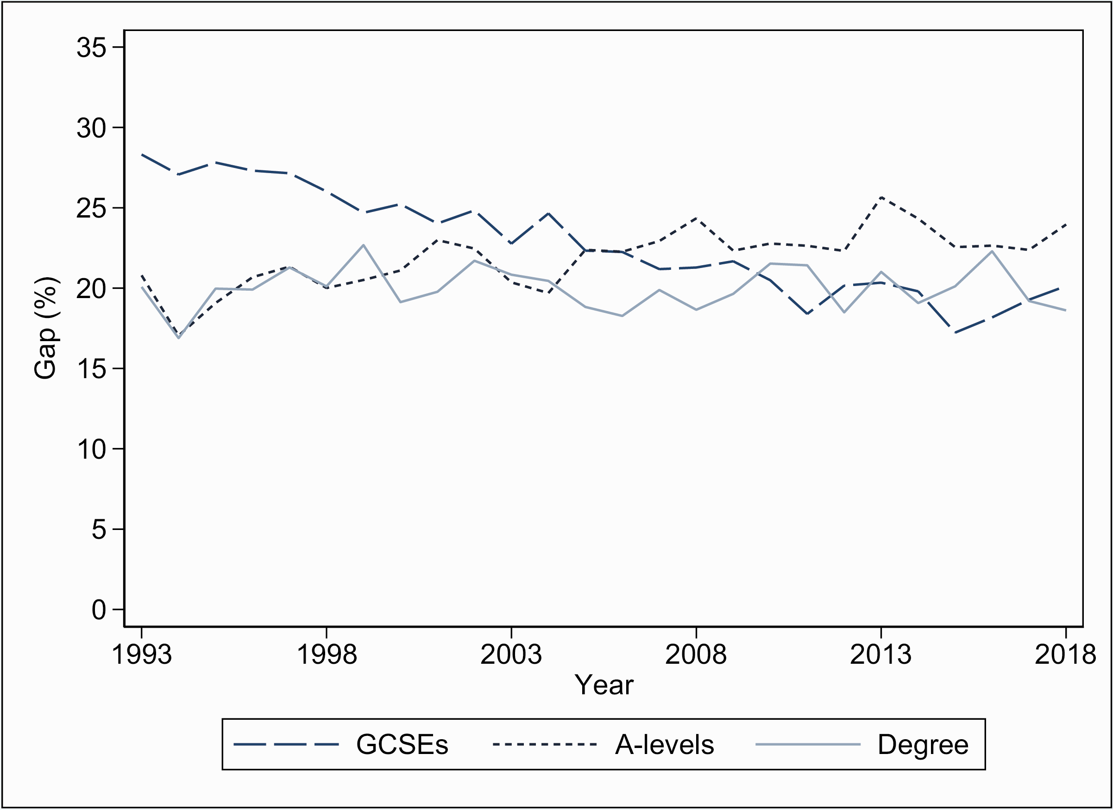
By highest educational qualification …
Source: Costa Dias et al. 2021 (https://doi.org/10.1093/oxrep/graa053). LFS 1993–2018. The gender wage gap is the percent difference in male and female average hourly wages.

Slide 25
What could be some explanations for why women (persistently) earn less than men?

Slide 26
Firms, industries, and occupations
Occupation and industry are now the biggest explanators of gender wage differences (Blau and Kahn 2017 for the U.S.)
Linked employer-employee data: much of the gender wage gap is accounted for by firms:
  Men locate in firms that pay higher wages to all their employees
  Less of a role for within-firm pay gaps.
See Card, Cardoso, and Kline (2016), Jewell et al. 2020 (for UK) and OECD 2021: The role of firms in wage inequality.
Why does where you work matter so much for gender pay inequality?
Notes:
Gender wage gap by time to/since birth of first childNotes: UKHLS 1991 to 2017. Wage gap measured in proportion of male wages. Observations in the top one and bottom two percentiles of the wage distribution are excluded. The age-adjusted series shows the gap obtained from wage rates net of education-specific age effects.

Slide 27
Care sector employment
Source: Current Population Survey data for the U.S. and European Structure of Earnings Survey (SES), 2018.

Slide 28
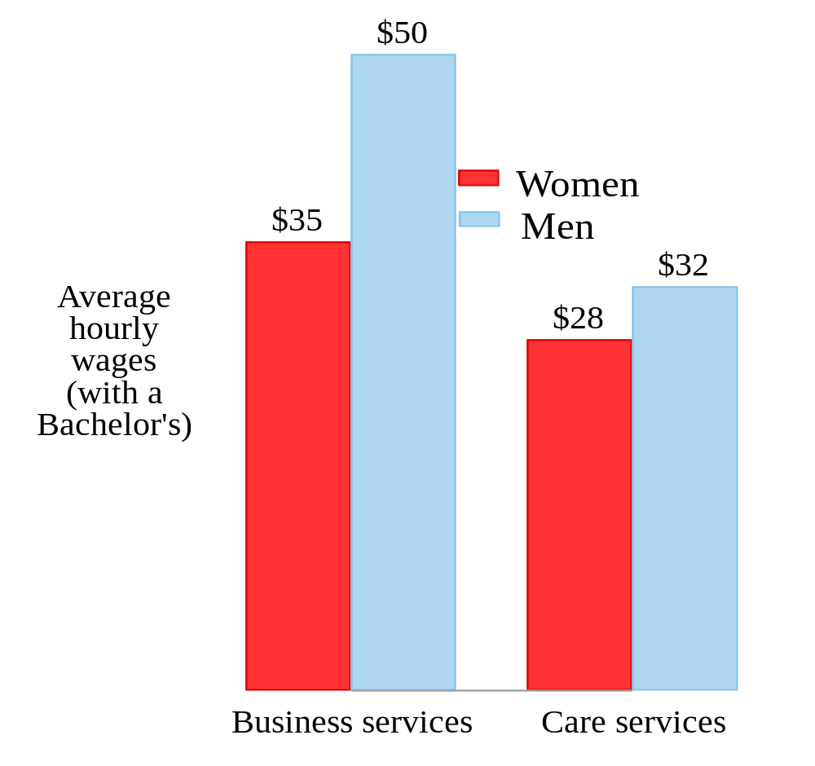
Care sector penalties
  Why do care providers earn so little?
  See England and Folbre 1999 for early feminist theorizations of the cost of doing care work.
Source: Current Population Survey data for the U.S. from 2013-2019. Restricted to full-time, full-year, private sector employees.
Notes:
Gender wage gap by time to/since birth of first childNotes: UKHLS 1991 to 2017. Wage gap measured in proportion of male wages. Observations in the top one and bottom two percentiles of the wage distribution are excluded. The age-adjusted series shows the gap obtained from wage rates net of education-specific age effects.

Slide 29
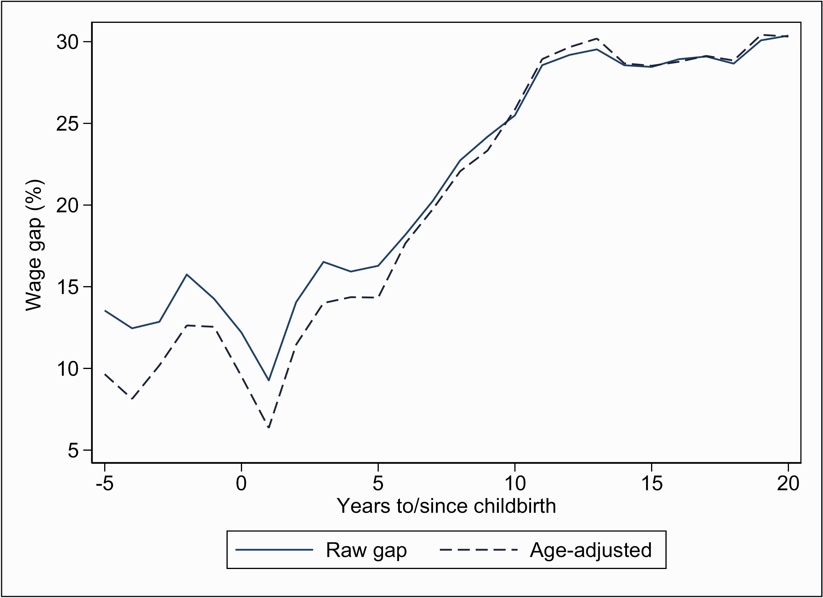
Gender wage gap by birth of first child in the UK
Source: Costa Dias et al. 2021 (https://doi.org/10.1093/oxrep/graa053). LFS 1993–2018. The gender wage gap is the percent difference in male and female average hourly wages.
Notes:
Gender wage gap by time to/since birth of first childNotes: UKHLS 1991 to 2017. Wage gap measured in proportion of male wages. Observations in the top one and bottom two percentiles of the wage distribution are excluded. The age-adjusted series shows the gap obtained from wage rates net of education-specific age effects.

Slide 30
Mainstream economics and market bias
“markets work efficiently and therefore … if some groups earn systematically less than others, it must be because they are less productive, or because they have chosen jobs that are more pleasant or flexible and therefore pay less.” (Lundberg, p. 11)
For example:
  Mothers paid less because they choose flexible / they are less productive.
  Women specialize in childcare and men in market work because of comparative advantage.
  Care jobs pay less because they satisfy social/altruistic preferences.

Slide 31
Feminist interventions on debates on the gender gaps in the labor market:
  Compensating differentials vs. care penalties.
  Human capital theory vs. devaluation of “feminine” jobs/tasks.
  Specialization: “comparative advantage” or social norms?

Slide 32
“A woman would need to be over 100 times more productive in market work than her male partner before reaching expected parity in domestic work” (Siminski and Yetsenga 2022)
If specialization cannot be explained by comparative advantage, what role do norms and bargaining play?
How do these norms change?
Who should bear the costs of children?

Slide 33
Brings us back to how feminist economists think about unpaid care:
Is raising children private consumption or a public good? Is the cost of children a matter for policy?
  Debates on falling fertility rates (a privatization of the cost, and socialization of benefits).

Slide 34
Limitations
Paid and unpaid care often studied in isolation:
Child penalties (Kleven et al. 2018, 2024) vs. pay penalties for paid care jobs (Folbre et al. 2023).
Gender divisions in unpaid care time vs. occupational and firm/industry segregation.
An interesting exception: Gonalons-Pons and Ansari (2025, Demography)
Feminist economics has been largely a microeconomic research project (Onaran and Oyvat 2023):
How do macroeconomic conditions affect paid and unpaid care provision?
How does the social organization of care affect labor supply and productivity?
Notes:
Gender wage gap by time to/since birth of first childNotes: UKHLS 1991 to 2017. Wage gap measured in proportion of male wages. Observations in the top one and bottom two percentiles of the wage distribution are excluded. The age-adjusted series shows the gap obtained from wage rates net of education-specific age effects.

Slide 35
Text sizes and hierarchy with an image
Feminist macroeconomics
  Care and national income accounting
  Macroeconomic processes/policies have gendered impacts
    Gender-differentiated impacts of crises
    Feminist critique and alternatives for austerity and macroeconomic policy
  Integrating care into macroeconomic models

Slide 36
Text sizes and hierarchy with an image
Modelling care
Integrates gender and care into macroeconomic models
  Care (also called social reproduction) is central to economic structures and processes, especially through role in the production and maintenance of the labor force
  Gender relations shape individual/household behavior
  In practice, integrating gender relations and the care sector into post-Keynesian models

Slide 37
Text sizes and hierarchy with an image
An example: Braunstein et al. (2011)
How do rising market participation and wages for women interact with economic growth?
It depends on:
how the income distribution influences aggregate demand
whether women’s rising market participation accompanied by greater sharing of unpaid work
  influences the production of human capital
  human capital enhances long-run production capacities and hence growth

Slide 38
Text sizes and hierarchy with an image
  Close links of feminist macroeconomics with post-Keynesian economics, but:
    both class and gender relations matter for effective demand, output, and growth
    recognizes supply-side constraints (via unpaid work and care) in addition to effective demand
    economic growth is not the only metric of assessing policy success—broader wellbeing matters
Notes:
Note overlap with human capital literature in mainstream economics: As such, investing in human capital is akin to investing in physical capital: one can invest in the human factor of production with the expectation of economic returns just as one can invest in the factor of production physical capital.1 Moreover, since human capital includes “education, training, medical care, and other additions to knowledge and health”, any policy affecting these areas affects human capital and, ultimately, growth.

Slide 39
Thanks!
Questions?
Also email me: l.gautham@leeds.ac.uk

Slide 40
Appendix: Time, income, and poverty

Slide 41
Consider married couples in the U.S.
 | Parents | Childless | Elderly
Real equivalized income | $60,940 | $81,306 | $57,925
Official poverty rate | 7% | 4% | 5%
Hours per week on rest and leisure | 101 | 111 | 127
Share in the sample | 17% | 13% | 10%
Source: CPS Annual Social and Economic Supplement (ASEC) 2003-2023, ages 18+. Time allocation imputed to ASEC respondents from American Time Use Survey (ATUS).

Slide 42
Zooming into parents
 | Single parents | Married-dual-earner | Married, single-earner
Real equivalized income | $25,427 | $70,544 | $48,811
Official poverty rate | 36% | 2% | 14%
Household hours per week by on housework and child supervision | 40 | 84 | 102
Share in the sample | 3% | 10% | 7%
Source: CPS Annual Social and Economic Supplement (ASEC) 2003-2023, ages 18+. Time allocation imputed to ASEC respondents from American Time Use Survey (ATUS).

Slide 43
Time poverty
“The need to work long hours, without choice, because the individual or household is income poor or risks falling into poverty if they were to reduce their working hours below a certain threshold,” with the consequence that “long working hours do not allow for sufficient rest and leisure.”
(Rodgers 2024, p.80)
Working hours = both paid and unpaid
  “Rest and leisure:” time not devoted to either paid or unpaid work.
Both paid and unpaid work contribute to material living standards.

Slide 44
Measuring income and time poverty
Two dimensions of non-market time:
Rest, leisure, and family time: cannot be outsourced to the market [maintenance time].
Household tasks (e.g., cooking, cleaning, child supervision) that can be outsourced to the market [substitutable household production].

Slide 45
Measuring income and time poverty
Two types of poverty:
Time poverty: Absence of time for maintenance (i.e., rest, leisure, and family time)
Extended income poverty: Material poverty
  Money-poor households (i.e., below the official money poverty line)
  OR
  Fall into money poverty if they have to purchase market substitutes for household tasks.

Slide 46
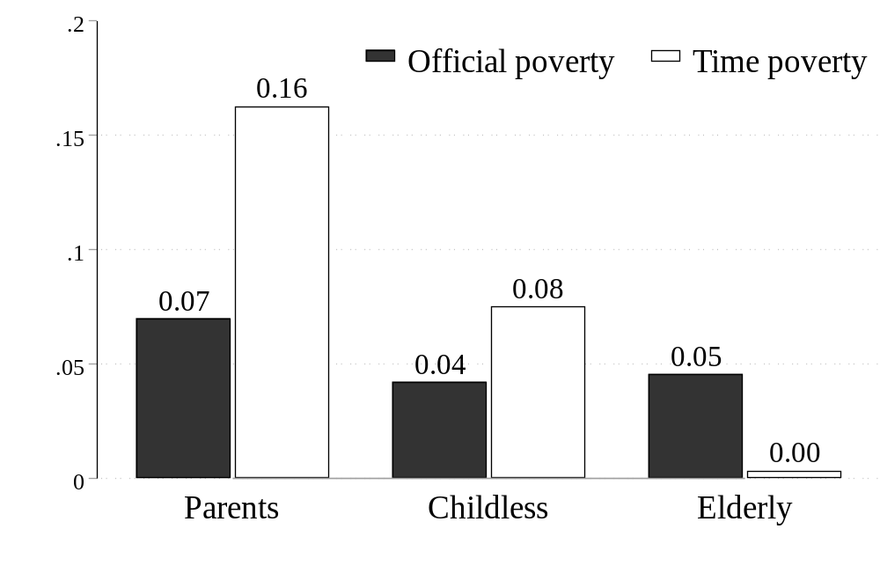
Who is time poor?
Source: CPS Annual Social and Economic Supplement (ASEC) 2003-2023, ages 18+. Time allocation imputed to ASEC respondents from American Time Use Survey (ATUS).

Slide 47
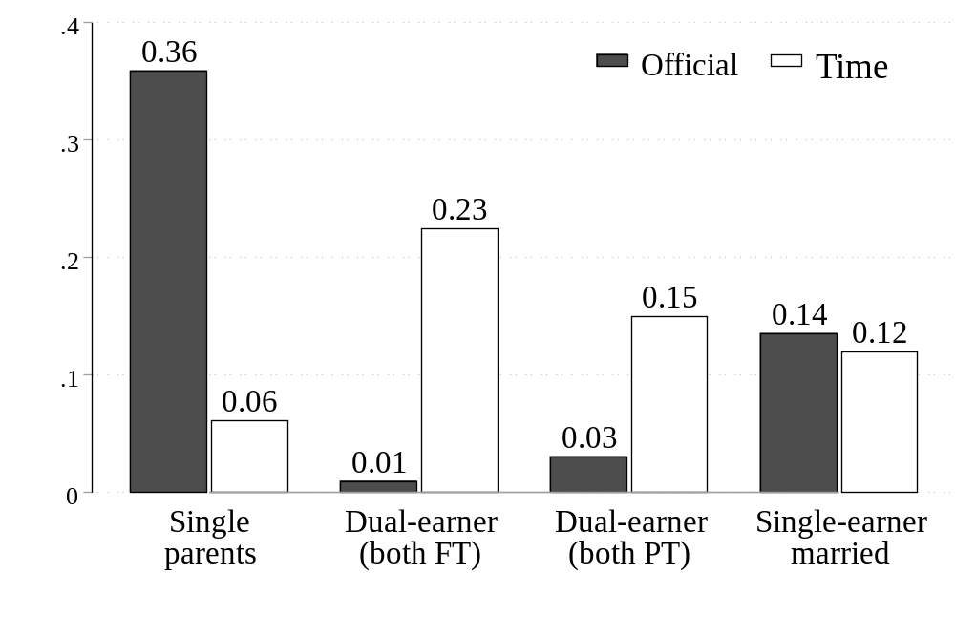
Who is time poor?
Source: CPS Annual Social and Economic Supplement (ASEC) 2003-2023, ages 18+. Time allocation imputed to ASEC respondents from American Time Use Survey (ATUS).

Slide 48
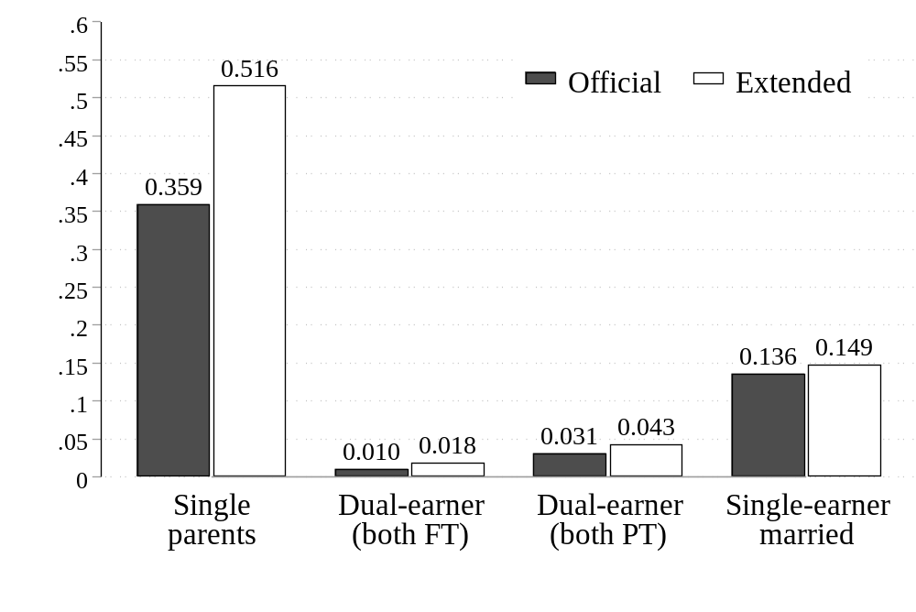
Extended income poverty among parents
Source: CPS Annual Social and Economic Supplement (ASEC) 2003-2023, ages 18+. Time allocation imputed to ASEC respondents from American Time Use Survey (ATUS).

Slide 49
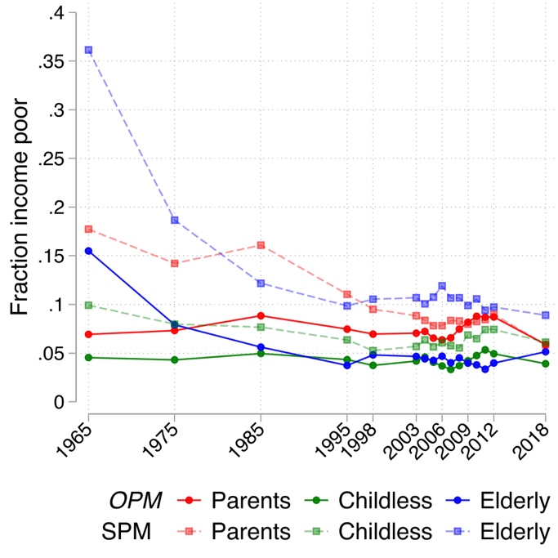
Long-run income poverty
Source: CPS Annual Social and Economic Supplement (ASEC) 1965-2023, ages 18+.

Slide 50
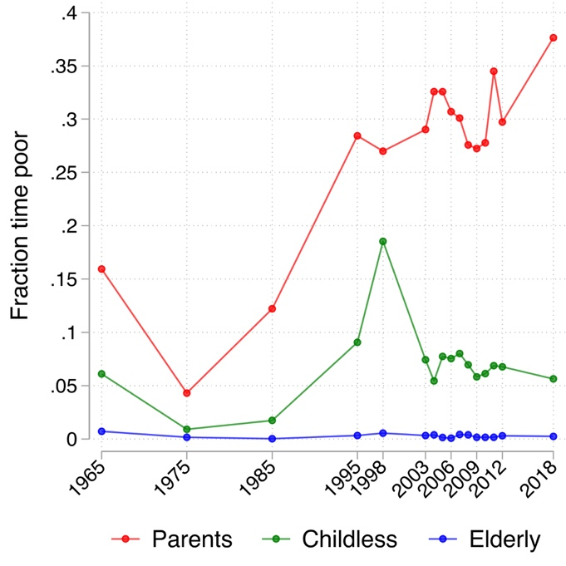
Long-run time poverty
Source: CPS Annual Social and Economic Supplement (ASEC) 1965-2023, ages 18+. Time allocation imputed to ASEC respondents from American Heritage Time Use Survey (AHTUS).

Slide 51
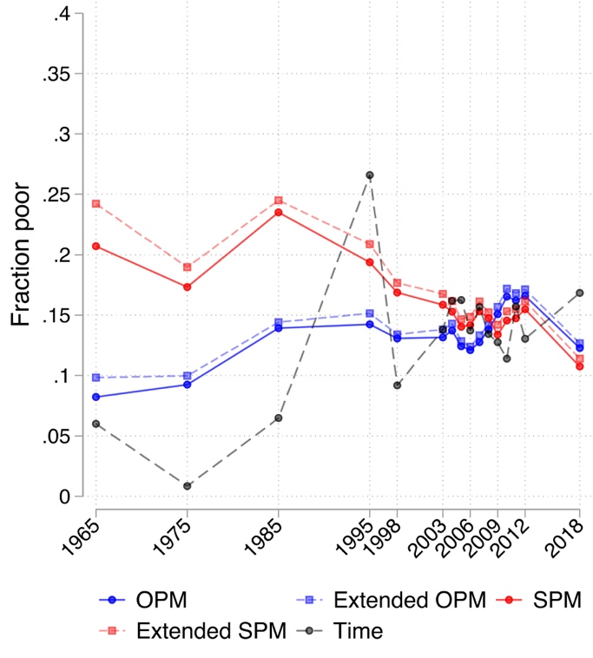
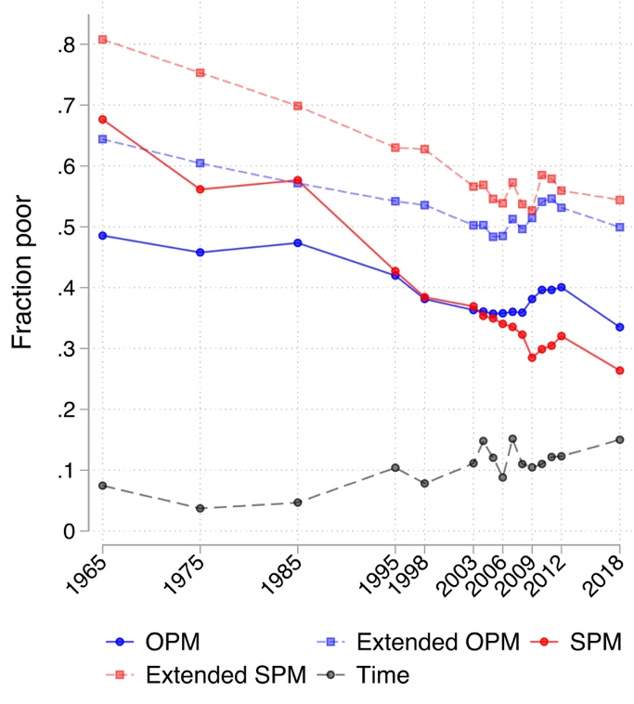
Long-run extended income poverty
Married, single-earner
Single parents
Source: CPS Annual Social and Economic Supplement (ASEC) 1965-2023, ages 18+. Time allocation imputed to ASEC respondents from American Heritage Time Use Survey (AHTUS).

Slide 52
Text sizes and hierarchy
A recap
What is unique about feminist economics?
Individual preferences shaped by norms, in turn the product of policies and collective action
Household decisions are the product of bargaining—power matters
Work includes unpaid and paid work
Important to measure and value unpaid work
Pluralism in methods

Slide 53
Appendix: Feminist macroeconomics

Slide 54
Text sizes and hierarchy
A hypothetical scenario …
The UK government wants to direct public spending towards policies that will increase employment and economic growth. It considers cutting back on SureStart centres (public nurseries for children under 4) saving £5 billion a year. These funds are then spent on transportation infrastructure that will complement and increase private sector investment.
How do you think this would affect overall employment, female employment, and economic growth?
Notes:
2 specifically in the context of the crisis

Slide 55
Text sizes and hierarchy with an image
Note mainstream overlap
  “Human capital includes education, training, medical care, and other additions to knowledge and health …” (Gary Becker, Nobel Prize Lecture: “The Economic Way of Looking at Life”, 1992)
  “… investing in human capital is akin to investing in physical capital … one can invest in the human factor of production with the expectation of economic returns just as one can invest in the factor of production physical capital.”
  (Flabbi and Gatti, A Primer on Human Capital, World Bank Policy Research Paper, 2018)
  But key differences remain.
Notes:
Early childhood education and health only received focus in mainstream recently. Feminist concept borrows more from Sen’s human capabilities—broader, includes emotional skills, social trust, and community wellbeing. Feminist economics also sees GDP/growth metric as fundamentally wrong for policy choice. Argues that human capital not necessarily chosen (e.g., educated) and from private sector, but also provided through care from families (altruistic preferences, primarily women) or the state (public provision, institutions). Human capital a social/public good rather than a private one.

Slide 56
Text sizes and hierarchy
Crises and women’s employment
The initial impacts of the GFC (2008-2010) hit male employment much harder in both the U.K. and the U.S. In contrast, we observe the reverse during the 2020-2021 economic downturn, with women’s employment declining by as much—or more—than men’s employment.
Why do you think this was the case?
Notes:
2 specifically in the context of the crisis

Slide 57
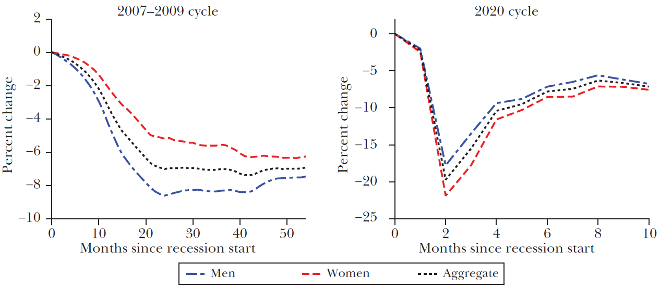
Text sizes and hierarchy with an image
Employment rate in the U.S. for GFC- vs. COVID-induced economic crises
Source: Albanesi and Kim (2021).
Notes:
From cause to consequences

Slide 58
Text sizes and hierarchy with an image
Crises have uneven impacts across sectors.
Gender segregation of jobs across sectors may either protect or expose women to job loss.
Women’s job loss also depends on the nature of the economic shock and the policy response that follows.
Notes:
Initial impacts of the crisis (2008-2010): higher rise in male compared to female unemployment in the U.K. (sectoral impact greatest on male-intensive industry and construction)
However, after 2010, male unemployment falls while female unemployment continues to rise in the U.K.; linked to cuts in public services (female-dominated public service employment)
Job creation favored men in the U.K.: for every 100 new jobs created after the crisis, only 37 went to women (Women’s Budget Group 2013)

Slide 59
Text sizes and hierarchy with an image
On macroeconomic policy
“Feminist economics … shows that decisions about economic policies, including determination of where investment is increased and where it is withdrawn, which services will flourish and which will be run down, and whose living standards will be protected or boosted, and whose reduced, are not gender neutral, even though they may make no explicit reference to gender.”
(Elson and Pearson, 2015; see also analysis by the U.K. Women’s Budget Group)

Slide 60
Text sizes and hierarchy with an image
Feminist critique of macroeconomic policy
Policy metrics focused narrowly on GDP/economic growth (exclude social and ecological concerns)
Austerity policies (e.g., 2010-2013 in the U.K.) with detrimental impacts on both social reproduction/care provision and gender equality
Public investment focuses on physical infrastructure (communication, transport, utilities) over social infrastructure (education, health, and social care classed as “consumption”)
Notes:
Social infrastructure classified as consumption rather than investment.

Slide 61
Text sizes and hierarchy with an image
References
Albanesi, S. & Kim, J. (2021). Effects of the COVID-19 Recession on the US Labor Market: Occupation, Family, and Gender. Journal of Economic Perspectives, 35(3), 3–24. https://doi.org/10.1257/jep.35.3.3
Becker, G. S. (1991). A Treatise on the Family. Harvard University Press.
Blau, F. D. & Kahn, L. M. (2017). The Gender Wage Gap: Extent, Trends, and Explanations. Journal of Economic Literature, 55(3), 789–865. https://doi.org/10.1257/jel.20160995
Braunstein, E., van Staveren, I. & Tavani, D. (2011). Embedding Care and Unpaid Work in Macroeconomic Modeling: A Structuralist Approach. Feminist Economics, 17(4), 5–31. https://doi.org/10.1080/13545701.2011.602354
Costa Dias, M., Joyce, R. & Parodi, F. (2021). The Gender Pay Gap in the UK: Children and Experience in Work. Oxford Review of Economic Policy, 37(1), 101–119. https://doi.org/10.1093/oxrep/graa053
Elson, D. & Pearson, R. (2015). Transcending the Impact of the Financial Crisis in the United Kingdom: Towards Plan F—A Feminist Economic Strategy. Feminist Review, 109(1), 8–30. https://doi.org/10.1057/fr.2014.42

Slide 62
Text sizes and hierarchy with an image
References
England, P. (2005). Emerging Theories of Care Work. Annual Review of Sociology, 31, 381–399. https://doi.org/10.1146/annurev.soc.31.041304.122317
England, P. & Folbre, N. (1999). The Cost of Caring. Annals of the American Academy of Political and Social Science, 561(1), 39–51. https://doi.org/10.1177/000271629956100103
Flabbi, L. & Gatti, R. V. (2018). A Primer on Human Capital. World Bank Policy Research Working Paper 8309. https://doi.org/10.1596/1813-9450-8309
Folbre, N. (2015). Valuing Non-Market Work. UNDP Human Development Report Office.
Jewell, S., Razzu, G. & Singleton, C. (2020). Who Works for Whom and the UK Gender Pay Gap. British Journal of Industrial Relations, 58(1), 50–81. https://doi.org/10.1111/bjir.12497
Kabeer, N. (2020). Women’s Empowerment and Economic Development: A Feminist Critique of Storytelling Practices in “Randomista” Economics. Feminist Economics, 26(2), 1–26. https://doi.org/10.1080/13545701.2020.1743338
Lundberg, S. (2023). Gender Economics: Dead-Ends and New Opportunities. Research in Labor Economics, 50, 151–189. https://doi.org/10.1108/S0147-912120230000050006.

Slide 63
Text sizes and hierarchy with an image
References
Rodgers, Y. V. M. (2024). Time Poverty: Conceptualization, Gender Differences, and Policy Solutions. Social Philosophy and Policy, 40(1), 79–102. https://doi.org/10.1017/S0265052523000389
Siminski, P. & Yetsenga, R. (2022). Specialization, Comparative Advantage, and the Sexual Division of Labor. Journal of Labor Economics, 40(4), 851–887. https://doi.org/10.1086/718430

