Slide 1
Development in Post Keynesian and Marxist Theories

Slide 2
Lecture Overview
What is development?
Measures of development
Development as structural transformation
Modernisation theory
Development & Keynesian/post-Keynesian thought
Structuralism
Kalecki as pioneer of development economics
Kaldor and development
Minsky: Financial fragility in developing countries
Development & Marxist/Marx-inspired thought
Neo-Marxism &
Dependency theory
Conclusion: What is missing?

Slide 3







Measuring level of development
China
Costa Rica
Cuba
Equatorial Guinea
UK
United Arab Emirate (UAE)
US

Slide 4
How to measure development?
Total GDP (US$, bn)
GDP p.c. (US$)
Human Development Index
US | 17,348.08
China | 10,430.71
UK | 2,991.69
UAE | 399.451
Cuba | 77.15
Costa Rica | 49.604
Equatorial Guinea | 15.53
US | 54,360.50
UK | 46,313.33
UAE | 42,943.78
Equatorial Guinea | 19,959.53
Costa Rica | 10,388.99
Cuba | 10,200 (PPP)
China | 7,625.79
US | 0.915 (8)
UK | 0.907 (14)
UAE | 0.835 (41)
Cuba | 0.769 (67)
Costa Rica | 0.766 (69)
China | 0.727 (90)
Equatorial Guinea | 0.587 (138)

Slide 5
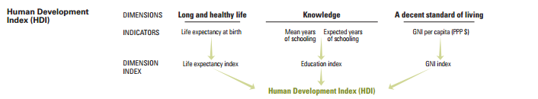
Human Development Index (HDI)
Inspired by Sen’s capabilities approach (Sen,1999, Development as Freedom)
Move away from a simple ‘money-metric’ measure of development
Not consumption but ‘functioning’ of human beings is important
Measures ‘key’ achievements of the population
Criticisms:
Why only these dimensions (income/gender inequality, environmental sustainability, safety…)
Composite indicators obscure information (Ravallion, 2010)

Slide 6
How to measure development?
Human Development Index
HDI (inequality adj.)
Gender Inequality Index
US | 0.915 (8)
UK | 0.907 (14)
UAE | 0.835 (41)
Cuba | 0.769 (67)
Costa Rica | 0.766 (69)
China | 0.727 (90)
Equatorial Guinea | 0.587 (138)
UK | 0.829 (16)
US | 0.760 (28)
Costa Rica | 0.613 (80)
China | .
Cuba | .
Equatorial Guinea | .
UAE | .
UK | 39
China | 40
UAE | 47
US | 55
Costa Rica | 66
Cuba | 68
Equatorial Guinea | .
Inequality adjustment: Based on household survey data, inequality in life expectancy, education and income are adjusted using the average as share of the min-max span of observations (see technical notes to Human Development Report, 2015).
Gender inequality index: Maternal mortality ratio, adolescent (15-19) birth rate, share of seats in parliament, population with at least some secondary education, labour force participation rate

Slide 7
Measures of development
Money-metric/GDP-based measures are increasingly seen as inadequate
Search for alternative concepts (e.g. ‘well-being’, Stiglitz & Fitoussi, 2009)
Careful with measurement in developing countries:
Problems with data availability
Problems with PPP (A. Deaton, 2010)
Problems with quality of data & comparability of data, esp. in poor countries (M. Jerven, 2013)
Subjective measures?

Slide 8
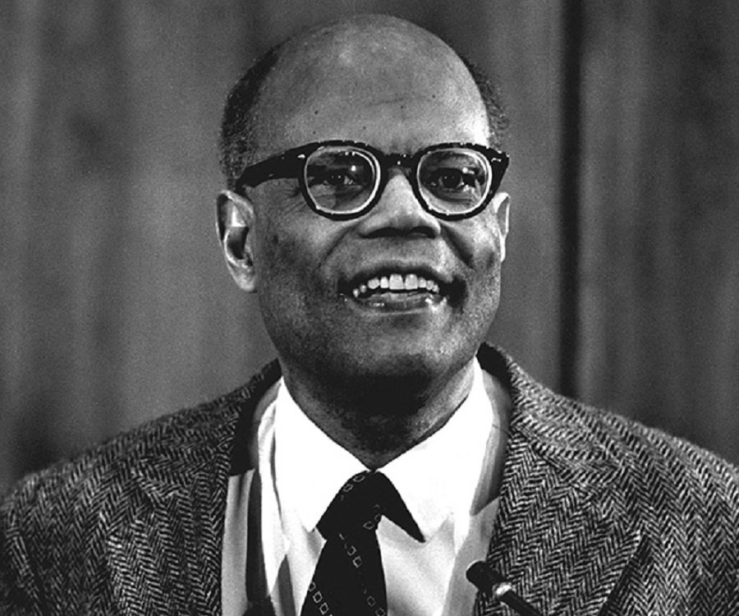
Development as structural transformation
Development economics only became an independent discipline in the 1950s.
Fundamental difference between poor & rich countries.
Structural differences
Therefore economic approach has to be different
Economic transformation is needed not just growth (manufacturing, technology)
Industrialisation is crucial
Lewis (1954): ‘Economic Development
with Unlimited Supplies of Labour’
Rejects both neoclassical & Keynesian
analysis, advocating return to classical
thought

Slide 9
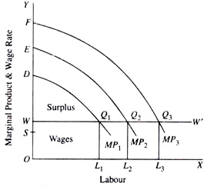
Modernisation theory
Illustration: Lewis model (Lewis’s capitalist nucleus)
Traditional sector | Modern sector
Subsistence agriculture, services Low tech Surplus labour (MPL = 0) | Capitalist production High tech Constraint by limited saving/capital
Surplus labour in the traditional sector keeps wages low (W)
Allowing capitalists to reinvest their surplus, expanding employment (L)
Lewis turning point: all surplus labour is absorbed
Hydraulic model of development
Crucially dependent on re-investment & low wages!

Slide 10
Modernisation theory & Keynesian influence
Modernisation theory | Keynesian influence
Development as driven by capital accumulation BUT: Saving → Investment | Investment drives economic activity
Eliminating surplus labour as aim of development BUT: Low wages as necessary | Focus on employment
Lewis (1954): ‘The central problem in the theory of economic development is to understand the process by which a community which was previously saving and investing 4 or 5 per cent of its national income or less, converts itself into an economy where voluntary saving is running at about 12 to 15 per cent of its national income or more.’
Proactive government stance (e.g. Rosenstein-Rodan’s ‘big push’) | Government intervention necessary to fight deficient demand
Planning (e.g. five year plans) But: Hydraulic planning | Use of ‘Keynesian’ models: Harrod-Domar model But: Simplistic reading of HD model
Optimistic outlook for policy impact | Optimistic outlook for policy impact

Slide 11
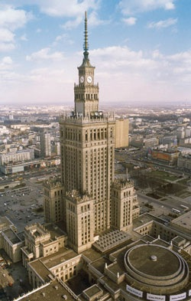

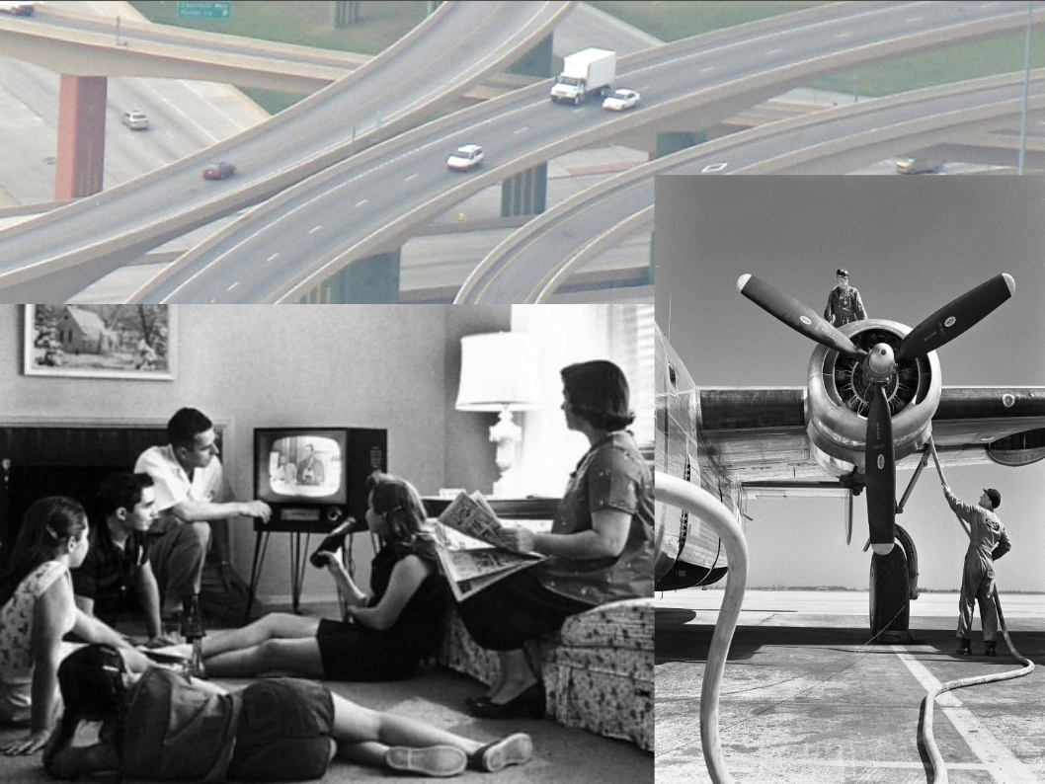
Remember the historical & political background
Golden era Fordism
De-colonialisation
The success of the Soviet union

Slide 12

Kalecki, pioneer of development thinking
Little acknowledged in development circles
1946-1955: work for Economic Department of UN Secretariat,
in charge of the World Economic Report
Kalecki’s work questioned modernisation theory (see Osiatyński, 1993: Collected Works of MK, Vol. 5, for development contributions):
Necessity of low wages: rising wages
  stimulate domestic demand
Neglect of agriculture: difference between
price formation in manufacturing &
agriculture
Necessity for institutional change in
agricultural sector

Slide 13
Kalecki, pioneer of development thinking
Automatic re-investment of profits:
capitalists might be unwilling
why? existence of rentiers, class interests (Kalecki, 1943)
semi-industrialised countries: idle capital goods
Solution: state-led investment (deficit spending) financed through taxation on profits and the rich
Balance of payments pressures?
strict capital controls & planned investment
r = (i/k) + u – d
r: rate of productive capacity growth
i: rate of gross investment
k: capital-output ratio
u: external rate of production growth
d: depreciation

Slide 14
Structuralist thought
Structural difference between rich and poor countries
Focus: open/global economy
Plus: What you make matters!
Raul Prebisch & the Economic Commission of Latin America (ECLA, 1948)
Policy: Import-substituting industrialisation (ISI)
Core | Periphery
Rich countries | Poor countries
High (domestic) tech | Low tech, pockets of high (foreign) tech
Consumer & investment goods (high income elasticity of demand) | Primary goods (low income elasticity of demand)
Low population growth, high employment share & higher wage share in productivity increases | High population growth, low employment share & low share in productivity increases (often captured by foreign companies)

Slide 15
Kaldorian development economics
Close to the LA structuralists
Kaldor’s Growth Laws (Kaldor, 1966, Sen, 1983):
Manufacturing as engine of growth:
  manufacturing sector growth is positively associated with growth in total output &
  the share of manufacturing activity in total GDP is positively associated with income per capita
Increasing returns (A. Young)
Verdoorn’s Law
Positive long-run relationship between productivity & output growth
  Growth in output increases productivity
  Cumulative process
  Due to increasing returns
  Learning (Wright, 1936)
Export-led growth

Slide 16
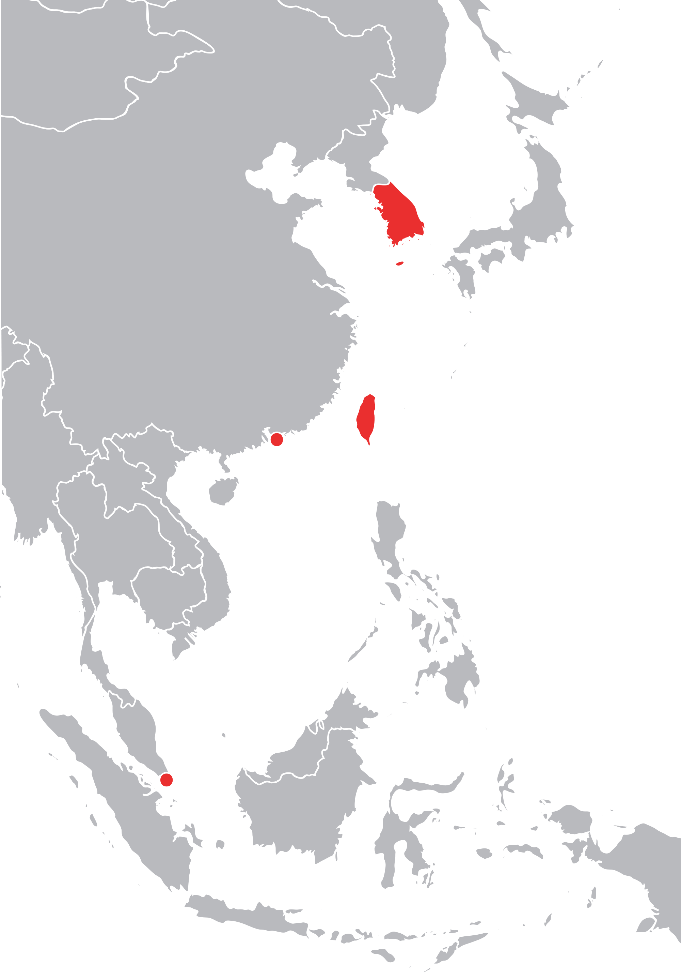
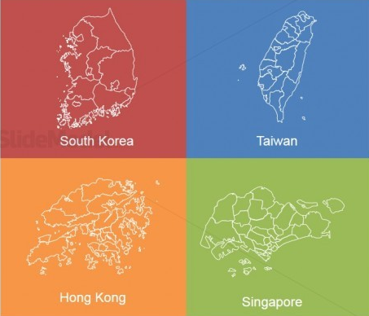
The East Asian Miracle
Japan and the East Asian tigers have successfully developed
through industrialisation and export-led growth
following Kaldorian principles
They were followed by other Southeast Asian countries (Malaysia, Thailand, Indonesia, Philippines, Lao, Vietnam).
Their strong growth & their strong ‘fundamentals’ meant the East Asian Crisis (1997/8) came as a ‘shock’ to investors.

Slide 17
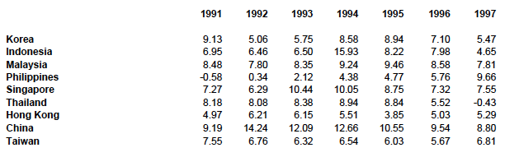
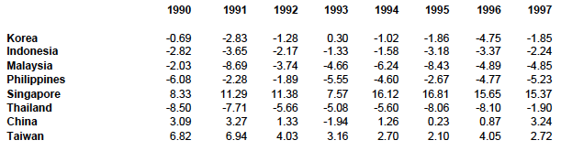
East Asian ‘Fundamentals’
GDP growth
Current account position (% of GDP)

Slide 18
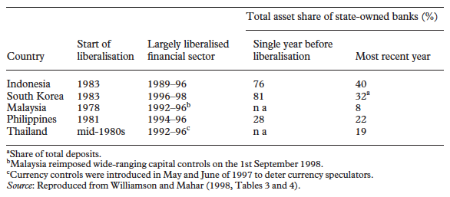
Minskyan analysis of finance fragility in developing countries
Minsky’s analysis mostly centres on a ‘rich’ closed economy (e.g. the US)
Open economy in developing countries (see Kregel, 1998, Dymski, 1999, Arestis & Glickman, 2002):
Balance sheet mismatches and changes in cash flow to liability ratios due to foreign exchange movements
The build-up of fragility: short-term foreign-denominated borrowing (‘super-speculative position’, Arestis & Glickman)
While individual country experiences varied, ‘Big Government’ and regulation were rolled back across many of these economies since the late 1980s (financial liberalisation).

Slide 19
Neo-Marxism & dependency
Pessimistic view of development possibilities for ‘underdeveloped’ countries
Focus: open/global economy + Marxist analytical lens & class analysis
Neo-Marxism | Dependency
Stressed imperialism | Stressed dependency of the periphery
Analytical focus on core | Analytical focus on periphery
Development of ‘underdeveloped’ countries is not possible in the global capitalist system | Development of dependent countries is strongly hindered by core-periphery dynamics
 | Structuralist & Neo-Marxist influences

Slide 20
Neo-Marxism
Paul Baran (1957) The Political Economy of Growth
Monopoly capitalism
  Emerged in the course of the 19th century in Europe
  Dampened investment (falling rate of profit)
Imperialism (Hobson, Luxembourg, Lenin)
  The search for surplus abroad
Class
  Control of means of production and over distribution of surplus
Economic surplus: reinterpretation
  Actual: difference between actual output and actual consumption
  Potential: difference between potential output and essential consumption

Slide 21
Neo-Marxism
Core | Periphery
Monopoly capitalism | Landlords, commercial bourgeoisie, monopoly capitalists, foreign capitalists
Industrialised | Needs to industrialise to develop
Repatriation of profits from developing countries by MNCs | External constraints: investment goods need to be imported, skilled labour is often foreign, presence of foreign capitalists
 | Internal constrains: Domestic monopoly capitalists & landlords Capitalism as non-productive force
Outcome: marginalisation of the masses, concentration of wealth among the few
Solution: autarky or socialist development

Slide 22
How does underdevelopment happen?
André Gunder Frank (1957) Development of Underdevelopment
Through trade relations
  Capitalism defined by the market
  Spatial dimension: metropolis-satellite polarisation
  Each metropolis (rural, local, regional, national, world centres) faces monopoly capital at the high level, leading to surplus extraction
Arghiri Emmanuel (1969) Unequal Exchange. A Study of the Imperialism of Trade
Because wages are lower in developing countries (surplus labour), goods from developing countries exchange for lower prices
Similarity with Lewis’s ideas
Weakness of labour organisations in developing countries
Capitalists & workers in rich countries form a coalition against poor country workers

Slide 23
Dependency
‘Neither Lenin (1917), nor Bukharin (1966) and Rosa Luxembourg (1964)…nor the few non-Marxist writers like Hobson (1965)…approached the question of imperialism from the point of view of the dependent countries. Although dependence has its place in the general framework of a theory of imperialism, it also possesses a force of its own which entitles it to a specific place in the general process which is itself influenced by it.’
(Dos Santos, 1969, as cited in Hunt, 1989)
Failure of ISI?
BoP pressures were aggravated
Real wages did not rise sufficiently quickly to stimulate demand
Income distribution worsened in several countries
Production became concentrated in sectors producing goods for the elites

Slide 24
Dependency
Why has ISI failed? (Dos Santos, 1970):
Transformation of economy is hindered by the dependence on export earnings
The monopolised international market determining trade relations makes BoP deficits likely
Financial dependence on foreign finance: repatriation of profits
Technological dependence on machinery/technology imports from the core; they also limit labour absorption
Criticisms:
Conceptualisation of surplus
Frank’s understanding of capitalism
Bill Warren claimed that dependency was increasingly eliminated in some countries (growing total GDP in many developing countries, growing manufacturing sectors)

Slide 25
Conclusion: What is missing?
What’s the role for labour/trade unions?
Can we keep on growing? (de-growth)
Environmental issues & sustainable development
Gender dimension
Financialisation/ financial dependency

Slide 26
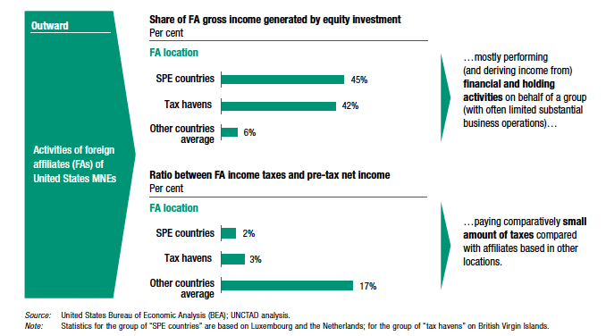
FDI: Opportunities?
MNCs & taxation

