Slide 1
Development from post-Keynesian and Institutionalist Perspectives
Esra Ugurlu
University of Leeds
13th Post Keynesian Economics Society Summer School
21 June 2024

Slide 2
Outline
Thirlwall’s Balance of Payments Constrained Growth Model (BPCGM)
Background
Formal model
Policy implications
Extensions
Critiques
Alternative Views on the Real Exchange Rate (RER) Policy
Economics of RER undervaluation
Data & stylised facts
Political economy considerations
Changing perspectives on exchange rate scepticism

Slide 3
1. Thirlwall’s Balance of Payments Constrained Growth Model (BPCGM)

Slide 4
Background (1/2)
One of the most used approaches to modelling long-run growth among post-Keynesian economists.
Popular approach to study development issues and (the lack of) convergence of developing countries to the per capita income levels achieved by advanced economies.
Why do countries grow at different rates?
Thirlwall shares the post-Keynesian belief that AD is paramount in determining a country’s growth rate.
The key constraint lie in the international domain
What does it mean for an economy to be balance-of-payments constrained?
Thirlwall’s Law:
$g_{b}=\frac{the growth rate of exports}{income elasticity of demand for imports}$

Slide 5
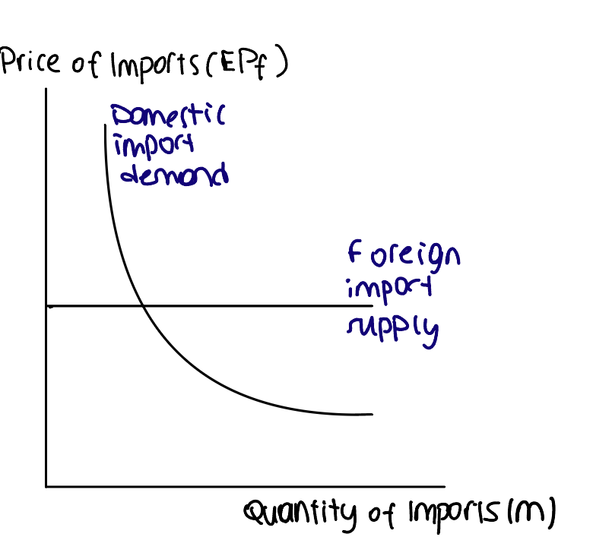
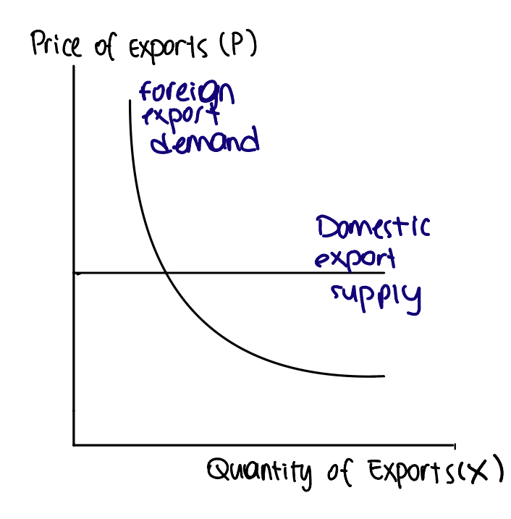
Background (2/2)
Two goods:
A domestically produced good (can be purchased at home or exported)
A foreign produced import good
Imperfect substitutes
The ‘law of one price’ does not apply
Supplies of exports and imports are infinitely elastic
The quantities traded are uniquely determined by the demand for each.
Do you find these assumptions convincing?
Source: Blecker and Setterfield (2019, p. 432 , Figure 432)

Slide 6
The Model (1/3)
Export demand:
$X=X_{0}{(\frac{EP_{f}}{P})}^{ε_{X}}Y_{f}^{η_{X}}$; $ε_{X}>0; η_{X}>0$ (1)
Import demand:
$M=M_{0}{(\frac{EP_{f}}{P})}^{−ε_{M}}Y^{η_{M}}$; $ε_{M}>0; η_{M}>0$ (2)
Balance of payments (assuming no net financial flows in the LR)
$PX=EP_{f}M$ (3)
Expressing in the growth-rate form:
$\hat{P}+x=\hat{E}{+\hat{P}}_{f}+m$ (4)
$x$= $ε_{X}\left(\hat{E}+\hat{P_{f}}−\hat{P}\right)+η_{X}y_{f}$ (5)
$m$= $−ε_{M}\left(\hat{E}+\hat{P_{f}}−\hat{P}\right)+η_{M}y$ (6)
Substituting (5)-(6) into (4)
$\left(ε_{X}+ε_{M}−1\right)\left(\hat{E}+\hat{P_{f}}−\hat{P}\right)−η_{M}y+η_{X}y_{f}=0$ (7)

Slide 7
The Model (2/3)
$\left(ε_{X}+ε_{M}−1\right)\left(\hat{E}+\hat{P_{f}}−\hat{P}\right)−η_{M}y+η_{X}y_{f}=0$ (7)
Which variables adjust to make this equilibrium hold in the LR?
$ε_{i}$and $η_{i}$ ($i=X,M$) are exogenously given
$y_{f}$ is exogenously given
Three possibilities: (1) $y$, (2) $\left(\hat{E}+\hat{P_{f}}−\hat{P}\right)$, or (3) a combination of (1) and (2)
Thirlwall assumed that income (or output) is the adjusting variable, not RER.
$y_{B}=\frac{\left(ε_{X}+ε_{M}−1\right)\left(\hat{E}+\hat{P_{f}}−\hat{P}\right)+η_{X}y_{f}}{η_{M}}$ (8)

Slide 8
The Model (3/3)
$y_{B}=\frac{\left(ε_{X}+ε_{M}−1\right)\left(\hat{E}+\hat{P_{f}}−\hat{P}\right)+η_{X}y_{f}}{η_{M}}$ (8)
Mixed empirical support for the ML condition
‘Elasticity pessimism’
$ε_{X}+ε_{M}≈1$, then;
$y_{B}=\frac{η_{X}y_{f}}{η_{M}}$ (9)
Even if $ε_{X}+ε_{M}>1,$we can assume $\left(\hat{E}+\hat{P_{f}}−\hat{P}\right)=0$
Constant RER in the long-run
Substituting $\left(\hat{E}+\hat{P_{f}}−\hat{P}\right)=0$ into the export demand function ($x$= $ε_{X}\left(\hat{E}+\hat{P_{f}}−\hat{P}\right)+η_{X}y_{f}$)
$y_{B}=\frac{x}{η_{M}}$ (10)
The strong form of Thirlwall’s Law
The weak form of Thirlwall’s Law

Slide 9
Policy Implications (1/2)
Exports are important.
Why?
To offset imports
“It maybe possible to initiate a consumption-led, investment-led or government expenditure-led growth, for a short time, but each of these components of demand has an import component. ... If there are no export earnings to pay for the import content of other components of expenditure demand will have to be constrained.” (Thirlwall 2002, p. 53)
Thirlwall’s Model & PK approach of demand-driven growth
Broadly consistent
Focus on the constraints imposed by investment demand vs. exports (relative to the propensity to import)
Are there any supply-side policy implications following from this model?
How to achieve a high $η_{X}$?
Composition of exports matters.
Education, infrastructure, R&D

Slide 10
Policy Implications (2/2)
Policy implications of elasticity pessimism
What matters is the non-price competitiveness of a country’s goods.
Cost competitiveness is unimportant.
How do we square this with the mounting evidence on the growth-inducing effects of undervalued (or competitive) RER policies? (Rodrik 2008, Razmi et al. 2012, etc.)
Does not support a blanket protectionist policy or ‘trade war’ approach.
A cautious approach to trade liberalisation

Slide 11
Extensions
The Thirlwall’s basic model is extended in various directions:
International financial flows (Thirlwall and Hussain 1982)
Multi-sectoral models with structural change (Araujo and Lima 2007)
Imports of intermediate goods (Blecker and Ibarra 2013)
Partial pass-through (Setterfield and Blecker, 2019, section 9.4.1)
Cumulative causation and Verdoorn’s Law (Setterfield and Blecker, 2019, section 9.4.2)

Slide 12
Critiques
Testing a near-tautology? (Clavijo and Ros, 2015; Razmi, 2016)
Foreign income growth and domestic capital accumulation
Country size
Endogeneity of income elasticities (Krugman 1989)
Infinitely elastic supplies of exports
Unrealistic for some countries
The ‘small economy’ model is more appropriate for many developing nations (Ros, 2013; Razmi, 2016a)
Implications:
the equilibrium quantity of exports is supply constrained.
BoP constraints may still apply to small countries but more due to dependence on ToT for exports goods and capital accumulation in export industries.

Slide 13
Critiques
Level versus rates of change in relative prices
Mixed empirical evidence on the ML condition $ε_{X}+ε_{M}> 1$
Evidence on $\left(\hat{E}+\hat{P_{f}}−\hat{P}\right)=0$ assumption (in the LR) is more solid
“[E]ven if relative prices (RERs) don’t change continuously in the long run, this does not necessarily imply that the level of the RER may not have a significant impact on a nation’s growth”
Rodrik (2008), Eichengreen (2007), Razmi et al. (2012), Razmi (2016b)

Slide 14
2. Alternative Views on Real Exchange Rate Policy

Slide 15
Economics of RER Undervaluation
Large body of theoretical and empirical research on the benefits of undervalued RER (see Demir and Razmi 2021 for an overview)
Shifting resources into higher productivity tradable sector (Rodrik 2008)
Reaping immediate productivity gains and jumpstarting growth in low-income countries (Eichengreen 2007)
Diminishing the dependence on foreign capital inflows
Positive effects on investment (Razmi et al. 2012; Libman et al. 2019)
Positive gender outcomes (Erten and Metzger, 2019)
Lessons for the Thirlwall’s BPCGM literature

Slide 16
Data and Stylised Facts
Historically, RER has been on average overvalued in Latin America and undervalued in East Asia.
Source: Ugurlu and Razmi (2023)
Note: Negative (positive) values indicate overvalued (undervalued) RER

Slide 17
Political Economy Considerations
Why is the RER more overvalued in Latin America?
Structural reasons?
Natural resource endowments
Political economy reasons?
Import dependence and liability dollarisation making undervaluation undesirable even for export industries
Exchange rate populism; desire to tame inflationary pressures
Intellectual reasons?
ECLAC
Belief in elasticity pessimism

Slide 18
New Perspectives on Exchange Rate Policy
Competing visions of newer forms of Latin American developmentalism
Social Developmentalism
New Developmentalism
Fritz et al. (2022), “Developmentalism at the periphery: addressing global financial asymmetries”

Slide 19
 | Classical Developmentalism | Social Developmentalism | New Developmentalism
Key Strategy /vision | Import Substitution Industrialisation | Structural transformation through income redistribution | Export Oriented Industrialisation
Targets | - Expanded domestic markets (through stimulating consumption) - Increased industrial production - Balanced trade | - Reduced inequality - Expanded domestic markets (consumption) - Balanced trade | - Increased industrial production - Trade surplus
Tools | Active Industrial policy through public investment; State-owned enterprises Trade policy: Trade protectionism; Overvalued Real Exchange Rate (RER) | Social policy: income transfers Wage policy: real increases in minimum wage Fiscal policy: Emphasis on social transfers Trade policy: Moderate trade protectionism | Trade policy: Competitive RER policy; Industrial policy for export promotion Fiscal policy: Long-term balance with room for counter-cyclicality; Progressive tax reforms
Source: My elaborations based on Fritz et al. (2022)

Slide 20
Key Takeaways
According to the Thirlwall’s BPCGM;
increasing the growth rate of exports is key to raising the long run growth rate.
policies that increase the income elasticity of export demand or lower the income elasticity of import demand can permit faster growth in the long run.
the exchange rate policy is not likely to have a significant impact in the long run.
Extensions; large empirical literature testing the law; criticisms
Theoretical and empirical literature on the economics of RER undervaluation
RER has been historically overvalued in L. America. This could partly be explained by ‘elasticity pessimism’ and the intellectual biases of the L. American structuralist tradition.
The thinking on the exchange rate policy has been changing.

Slide 21
Thank you!
If you have any other questions, you can email me @ E.N.Ugurlu@leeds.ac.uk

Slide 22
References
Araujo, R.A. ad G.T. Lima, 2007, A structural economic dynamics approach to balance-of payments- constrained growth, Cambridge Journal of Economics, 31 (5), 755–74.
Blecker, R.A. and C.A. Ibarra (2013), ‘Trade liberalization and the balance of payments constraint with intermediate imports: the case of Mexico revisited’, Structural Change and Economic Dynamics, 25 (June), 33–47.
Blecker, R.A. and Setterfield, M., 2019. Heterodox macroeconomics: Models of demand, distribution and growth. Edward Elgar Publishing.
Demir, F., Razmi, A., 2021. The Real Exchange Rate and Development Theory, Evidence, Issues and Challenges. Journal of Economic Surveys.
Eichengreen, B., 2007. The real exchange rate and economic growth. Social and Economic Studies 7–20.
Erten, B., Metzger, M., 2019. The real exchange rate, structural change, and female labor force participation. World Development 117, 296–312.
Krugman, P., Taylor, L., 1978. Contractionary effects of devaluation. Journal of international economics 8, 445–456.
Libman, E., Montecino, J.A., Razmi, A., 2019. Sustained investment surges. Oxford Economic Papers 71, 1071–1095.
Razmi, A. 2016a ‘Growth and distribution in low-income economies: modifying post-Keynesian analysis in light of theory and history’, Review of Keynesian Economics, 4 (4), 429–49.
Razmi, A., 2016b, Correctly analysing the balance-of-payments constraint on growth, Cambridge Journal of Economics, 40 (6), 1581–1608.
Razmi, A., Rapetti, M., Skott, P., 2012. The real exchange rate and economic development. Structural Change and Economic Dynamics 23, 151–169.
Rodrik, D., 2008. The real exchange rate and economic growth. Brookings papers on economic activity 2008, 365–412.
Ros, J., 2013, Rethinking Economic Development, Growth, and Institutions, Oxford, UK: Oxford University Press.
Thirlwall, A.P. and M.N. Hussain, 1982, The balance of payments constraint, capital flows and growth rate differences between developing countries, Oxford Economic Papers, 34 (3), 498–510.
Ugurlu, E.N., Razmi, A., 2023. Political economy of real exchange rate levels. Journal of Comparative Economics 51, 918-940

